Slide 1
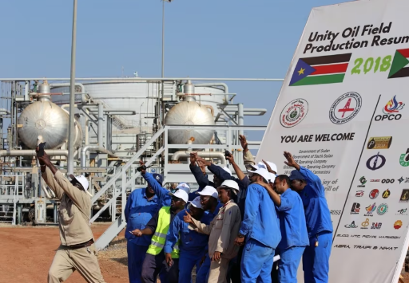
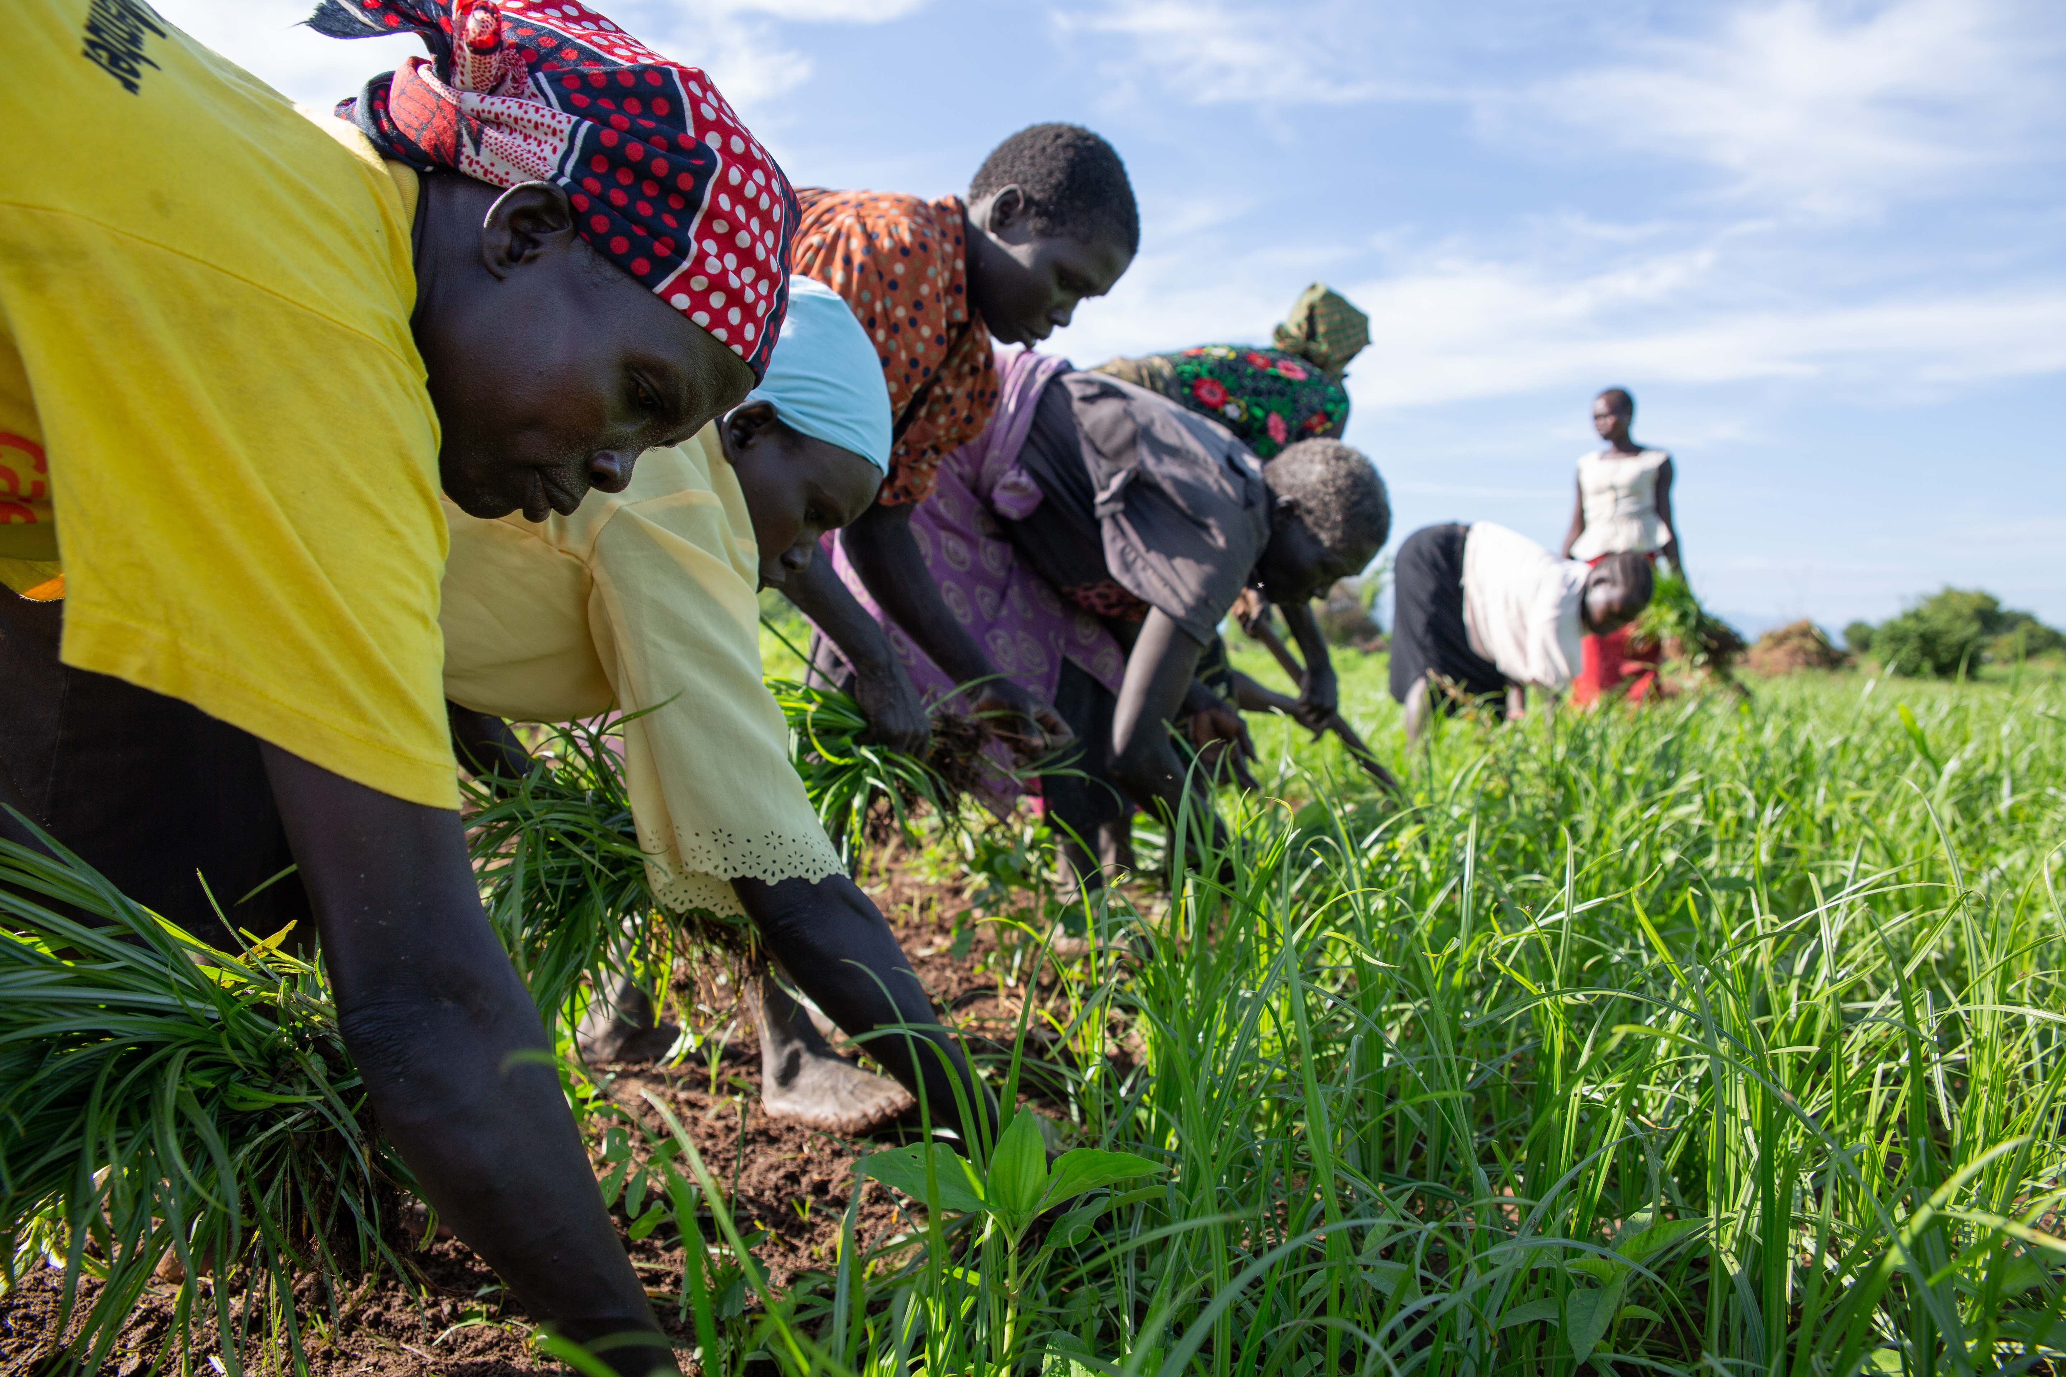

From Dependence to Diversification:
Natural Resources for Growth and Jobs
in South Sudan

Slide 2
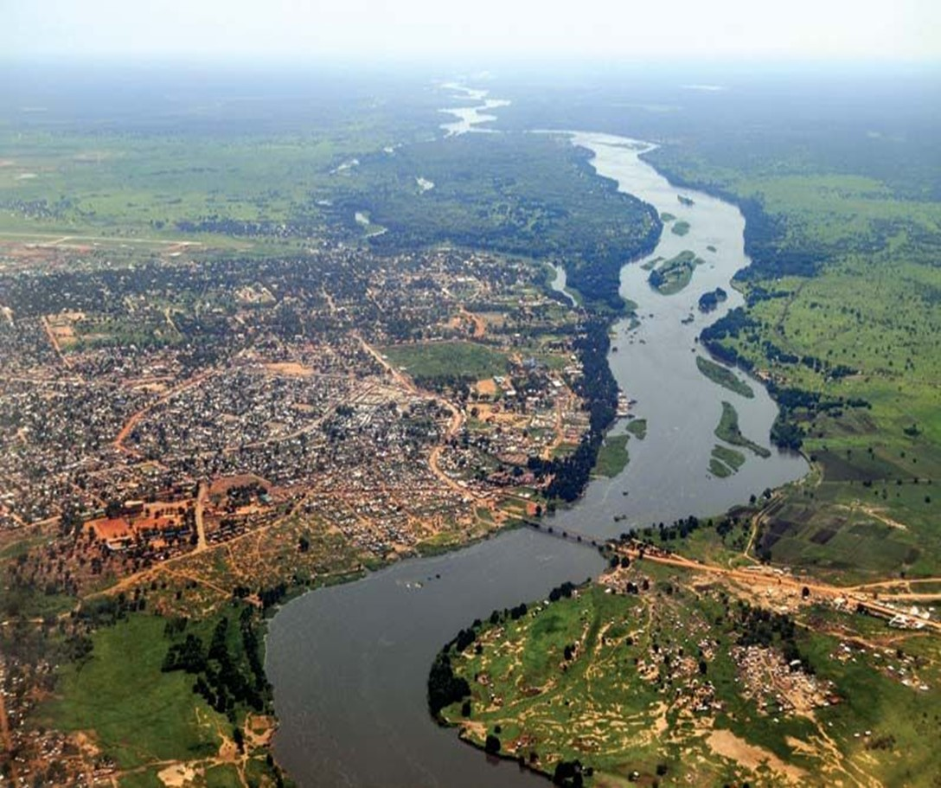
Outline
01. | Why the urgency: The unfulfilled promise of oil
02. | From dependence to diversification Principles and case studies
03. | What will it take: Directions for reforms

Slide 3
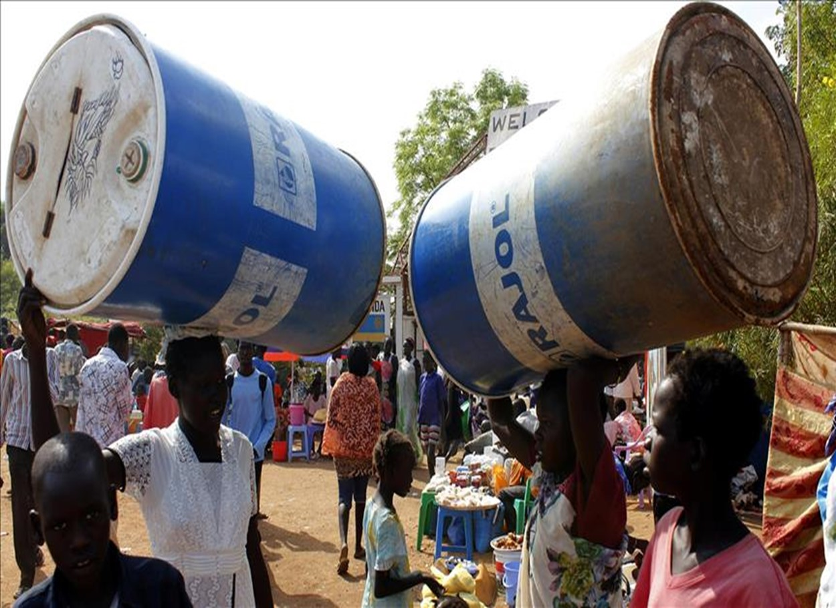
Why the urgency:
The unfulfilled promise of oil
https://www.worldbank.org/en/country/southsudan

Slide 4
South Sudan is caught in a “resource curse”
2022 GDP per capita was among the lowest in the world, and South Sudan is falling behind
Despite abundant natural resources, poverty has risen and development gains are limited
GDP per capita, US$
Selected Development indicators, South Sudan
UGA
Sources: IMF
https://www.worldbank.org/en/country/southsudan
Sources: World Bank, FAO

Slide 5
The unfulfilled promise of oil in South Sudan
Oil reserves are 3rd largest in Africa, but oil production fell to ½ the levels at independence due to civil war, flooding, and mismanagement of the oil sector
Post-civil war: economic recovery interrupted by multiple shocks (COVID-19, climate shocks, localized conflict, and global shocks)
GDP growth, percent
Oil reserves =3.5bn bbl
Sources: IMF estimates, 2023
Sources: IEA Oil Market Report, other
https://www.worldbank.org/en/country/southsudan

Slide 6
Challenges are amplified by competition over
(and mismanagement) of oil resources
Distribution of the Government’s oil revenue, FY22 Budget
Diversion of oil resources heavily constraints spending on development
(e.g., corruption, off-budget spending, repayment of oil-backed loans)
Source: World Bank estimates Country Economic Memorandum (2022). Ministry of Finance, FY2021/22 Budget

Slide 7
Why the urgency to diversify: heightened risks (old and new)
Macroeconomic reforms have begun but have further to go
  Foreign exchange market reforms
  Improvements in PFM systems
  Non-oil revenue reforms
  Transparency measures
  Capacity building for better governance
“Old” risks
  Crude oil price fluctuations (>90% of government revenues come from oil)
  Disruptions to oil production and exports
+ “Newer” risks
  Climate shocks (flooding and droughts), locusts, subnational violence
  Oil resources to become stranded assets in the long term
  Sudan crisis

Slide 8
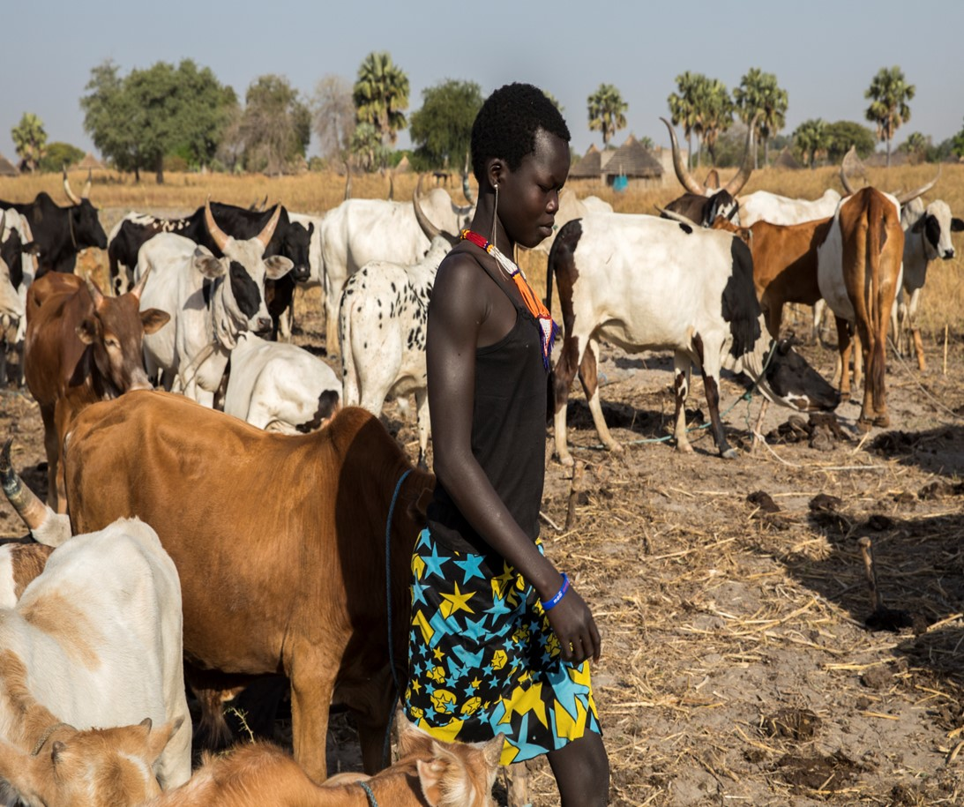
2. From Dependence to Diversification
Principles and
case studies
https://www.worldbank.org/en/country/southsudan

Slide 9
Moving from “below ground” assets to “above ground”
  Focus on building “above ground” assets: human capital, physical capital, and institutional capital to underpin future wealth
  Manage revenue exhaustibility and volatility
  Manage trade-offs: how much to spend/save, what to spend on
What is diversification?
  Are lower concentration of exports or production always more desirable?

Slide 10



Key lessons from the international experience
Integrated approach to manage oil by…
….strong institutions to steer resource revenues into diversified assets (human, physical, institutional)
…and transparency and accountability
A credible macro-fiscal framework that “ties the hands” of government
More efficient and effective use of resource revenues in support of diversification
Enhanced transparency in resource management, resource use and extractive sector
Integrate oil revenue and oil funds into the budget process – No parallel spending programs
Strengthen PFM systems for a credible and accountable budget
Improve public investment management to get value for money and resilience to climate shocks
Use resource funds to reinforce fiscal discipline, not as a separate policy tool
Publish detailed fiscal accounts, including data from resource funds and financial statements for public enterprises
Strengthen treasury, accounting and audit procedures
Fully implement the EITI
Insulate from volatility (e.g., fiscal rules)
Save for difficult times and for future generations (e.g., Sovereign Funds)
Gradually scale up spending for development considering what can be absorbed (mind capacity constraints)
Ensure that new borrowing does not compromise fiscal sustainability

Slide 11
Botswana: asset diversification
(independence in 1966, current pop: 2.5mn)
Successful at managing natural wealth
GDP per capita, US$ constant prices, PPP
Mining/Extractive sector,
Prudent resource management, strong institutions
Generous social sector spending used to accumulate/diversify financial, human and physical assets…
Less successful at economic diversification
Diamonds continue to drive the economy, govt revenues and comprise 90% of goods exports, and extractives receive bulk of FDI
Diversification hampered by large state footprint and monopolies, limited competition, import substitution policies
Future diversification efforts aimed at shifting from “mining minerals’ to ‘mining knowledge”

Slide 12
Timor Leste: building financial wealth and supporting development
(independence in 2002, post-conflict country, current pop: 1.3mn)
  Petroleum Fund established in 2005 to preserve wealth for future generations and support use of oil resources for development
  Between 2005-2021, $13bn transferred to budget to support development
  Economy has grown in sophistication, institutional capacity, life expectancy is up 10 years, and thousands lifted out of poverty
  Petroleum Fund governance is among the best in the world. Demonstrates viability of strong institutional arrangements in post-conflict environment to support longer term development
Selected Development indicators

Slide 13
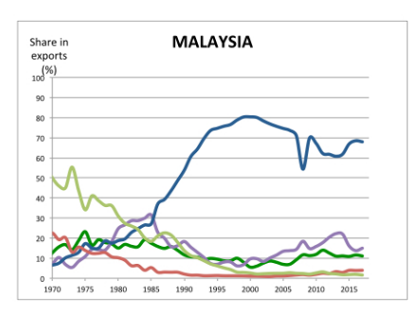
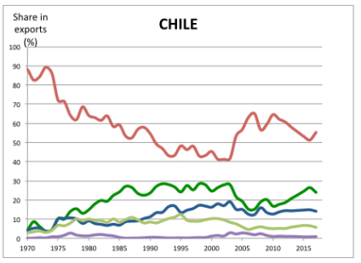
Malaysia and Chile: successful export diversification
State not only “facilitated” diversification, but shaped the direction of diversification
by linking the extractives sector with the rest of the economy
Targeted human capital accumulation/ technical training/ R&D to support vertical & horizontal diversification
Rules-based macro management, leveraging oil/copper rents to support human capital and infrastructure
Trade openness facilitated access to markets and integration into global/regional value chains
Malaysia: oil, agr-> manufacturing
Chile: copper -> high-value AGR products
Share of exports (%)
Share of exports (%)
Manufacturing
Agricultural raw materials
Ores and minerals
Fuel
Agricultural raw materials
Food
Manufacturing
Food
Ores and minerals
Fuel

Slide 14
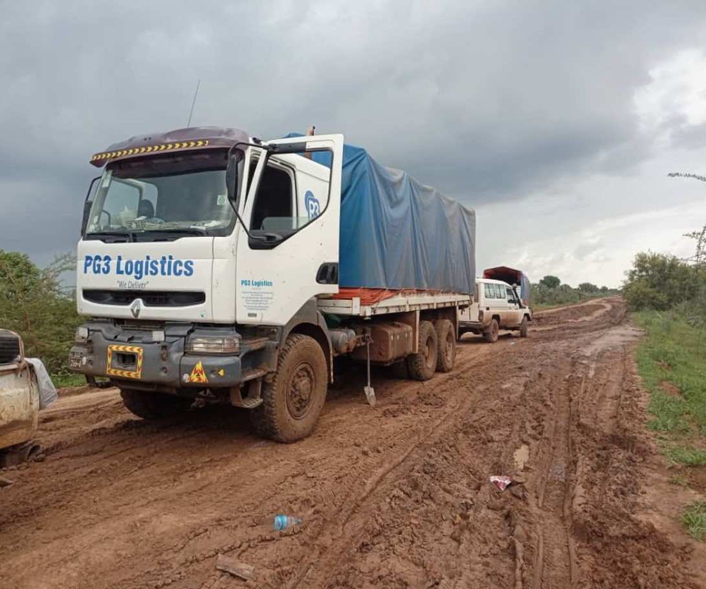
2. What will it take
Directions for reform

Slide 15
Leveraging natural capital requires peace, strong institutions, and prudent macroeconomic policies
Peace
Oil Sector Governance
Resilient
Agriculture Sector
Institutions
Macro Stability

Slide 16
Oil revenue investment options for South Sudan
Oil sector governance
Accountability
Governance
Economic Transformation
Public capital
Transfers to households
Public capital + sovereign fund

Slide 17
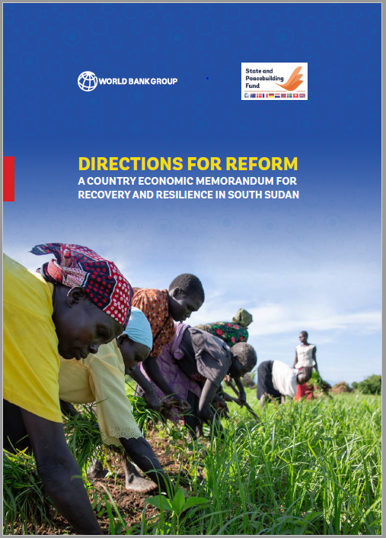
Thank you
www.worldbank.org/en/country/southsudan

