Slide 1
Using oil revenues to spur inclusive growth in South Sudan
Shanta Devarajan
Georgetown University
September 2023

Slide 2
The South Sudan paradox
3.5 billion barrels of oil reserves in 2011
About $250 billion
$16,667 for every person in South Sudan
$2 billion a year in oil revenues in 2021
Or $133 per capita

Slide 3
The South Sudan paradox (cont’d)
GDP per capita is half the level in 2011
Extreme poverty rate is 70 percent
Human Development Index 191/191
70 percent children out of school
7.8 million facing severe acute food insecurity
No job creation
Source: International Monetary Fund 2023

Slide 4
Resolving the paradox
Oil is the reason for the poor economic performance
Overarching problem is weak governance
Oil revenues undermine government accountability to the people

Slide 5
Overarching problem is weak governance
Failure of accountability
Public spending does not reach schools, clinics
Government unable to provide security to citizens
Hiring in the public sector crowds out private-sector job creation
Alternative causes
Civil conflict
External shocks
Climate change
Each of these are reflections of weak governance
Conflict: Desire by one faction to seize the resources of the state
Oil price shocks: Pro-cyclical policies (spending during boom times)
Climate change: Insufficient infrastructure maintenance

Slide 6
Oil revenues undermine accountability
Oil revenues go directly to the government without passing through the hands of citizens
Contrast with tax revenues which are paid by citizens

Slide 7
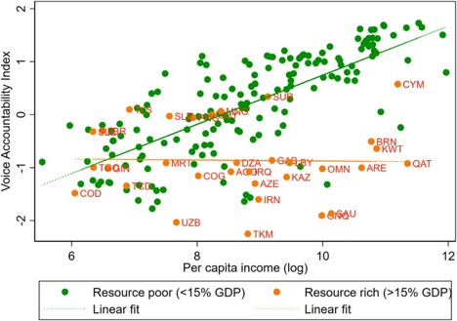
Resource-rich countries have lower accountability

Slide 8
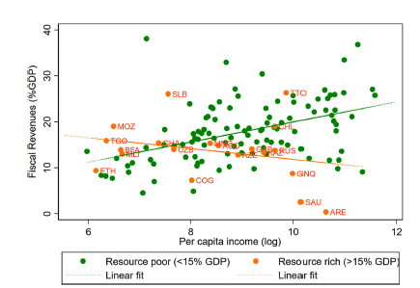
Resource-rich countries have lower tax revenues

Slide 9
Oil rents associated with worse health outcomes

Slide 10
Oil revenues and weak accountability in South Sudan
Poor service delivery outcomes (health, education): Government does not have to rely on citizens for revenue. Citizens lack voice.
Civil conflict: Whoever seizes control of the state gets revenues for which they are not accountable.
Public sector hiring crowds out private sector job creation.

Slide 11
What can be done? A proposal
Transfer oil revenues equally to all citizens
Tax citizens to finance public expenditures
Notes:
Citizens see a benefit from oil revenues
They can hold government accountable for public spending because of taxation. Government needs to curry favor with citizens to earn tax revenues.

Slide 12
Criticisms of the proposal…and responses
It’s never been done
Alaska (since 1975), Mongolia (2010)
It can’t be done in a poor, sparsely populated country
Can be done with mobile phones and unique ID (as in India, Kenya)
People will waste the money, stop working
No evidence of spending on “temptation goods” or reduction in labor supply
Government will not want to be accountable

Slide 13
Why this proposal is in the current government’s interest
Oil revenues will decline while expenditure needs increase
Government will have to rely on taxation in the future
But citizens may refuse to pay taxes if government has been misallocating funds
Government can signal that it will spend wisely by increasing its cost of misappropriating funds
By transferring some oil revenues today, government is increasing those costs
By not transferring oil revenues today, government risks falling into a poverty trap

Slide 14
Conclusion
South Sudan’s disappointing performance is due to its oil revenues, which undermine government accountability and public-expenditure outcomes
South Sudan can reverse the situation by transferring oil revenues directly to the citizens and then taxing them to finance public spending
This will enable citizens to hold government to account
Government will have to provide what citizens want
The people of South Sudan, especially the poor, have suffered for too long. The time to act is now.

