Slide 1
South Sudan: Building Non-Oil Revenue Mobilization
National Economic Conference
Rajul Awasthi
Lead Governance Specialist
September 2023

Slide 2
OUTLINE OF THIS PRESENTATION
South Sudan Revenue Position
South Sudan has one of the lowest non-oil revenues
Oil revenues highly volatile
South Sudan’s tax revenues totally skewed toward PIT
Non-oil revenues necessary for sustainable growth
Case Example: Nigeria
Reform areas identified by World Bank
Estimated potential revenue gains from reforms
CONFIDENTIAL: NOT TO CIRCULATE
2

Slide 3
SOUTH SUDAN HAS ONE OF THE LOWEST NON-OIL REVENUES IN THE WORLD
OIL REVENUES ARE HIGHLY VOLATILE AND DO NOT PROVIDE FISCAL STABILITY
Source: IMF Article IV Reports, WB calculations
CONFIDENTIAL: NOT TO CIRCULATE
3

Slide 4
South Sudan’s domestic revenue profile is majorly skewed towards the PIT; other taxes are under-utilized
Tax revenue as percent of total
PIT 93.7
BPT 3.0
Sales 2.1
Excise 1.2
Source: NRA Data; World Bank calculations
CONFIDENTIAL: NOT TO CIRCULATE

Slide 5
The average tax collections by tax instrument for AFR 31 Countries shows the tremendous potential SS has to increase tax-GDP
Tax collections as percent of GDP by tax type
Source: OECD Revenue Statistics Africa 2022

Slide 6
Improvements in Customs administration are also critical to increase revenues
Source: NRA Data; World Bank calculations
CONFIDENTIAL: NOT TO CIRCULATE

Slide 7
Research shows that sustainable economic growth needs a certain minimum level of non-oil tax revenues
IMF Working Paper
Tax Capacity and Growth: Is there a tipping point?
Vitor Gaspar, Laura Jaramillo, Phillippe Wingender
Key finding: The authors find that the answer to the question is Yes. The estimated tipping point is 12.75 percent of GDP, i.e., when non-oil tax to GDP reaches that level, a sustainable growth path is possible.
CONFIDENTIAL: NOT TO CIRCULATE

Slide 8
According to the IMF…
South Sudan is starting to reap the rewards of reform. For example:
Basic revenue administration institutions and infrastructure have been set up.
Tax and customs laws and regulations have been enacted.
Administrative procedures have been put in place for taxpayer registration.
Collection enforcement and taxpayer audits have begun.
A viable large taxpayer unit has been set up.
Operations at the largest border post have been improved.
Basic information technology systems have been implemented including a higher per capita availability of computers for the revenue administration.
Source: International Monetary Fund
CONFIDENTIAL: NOT TO CIRCULATE

Slide 9
Case example: Nigeria
Strategy to build revenue mobilization
CONFIDENTIAL: NOT TO CIRCULATE

Slide 10
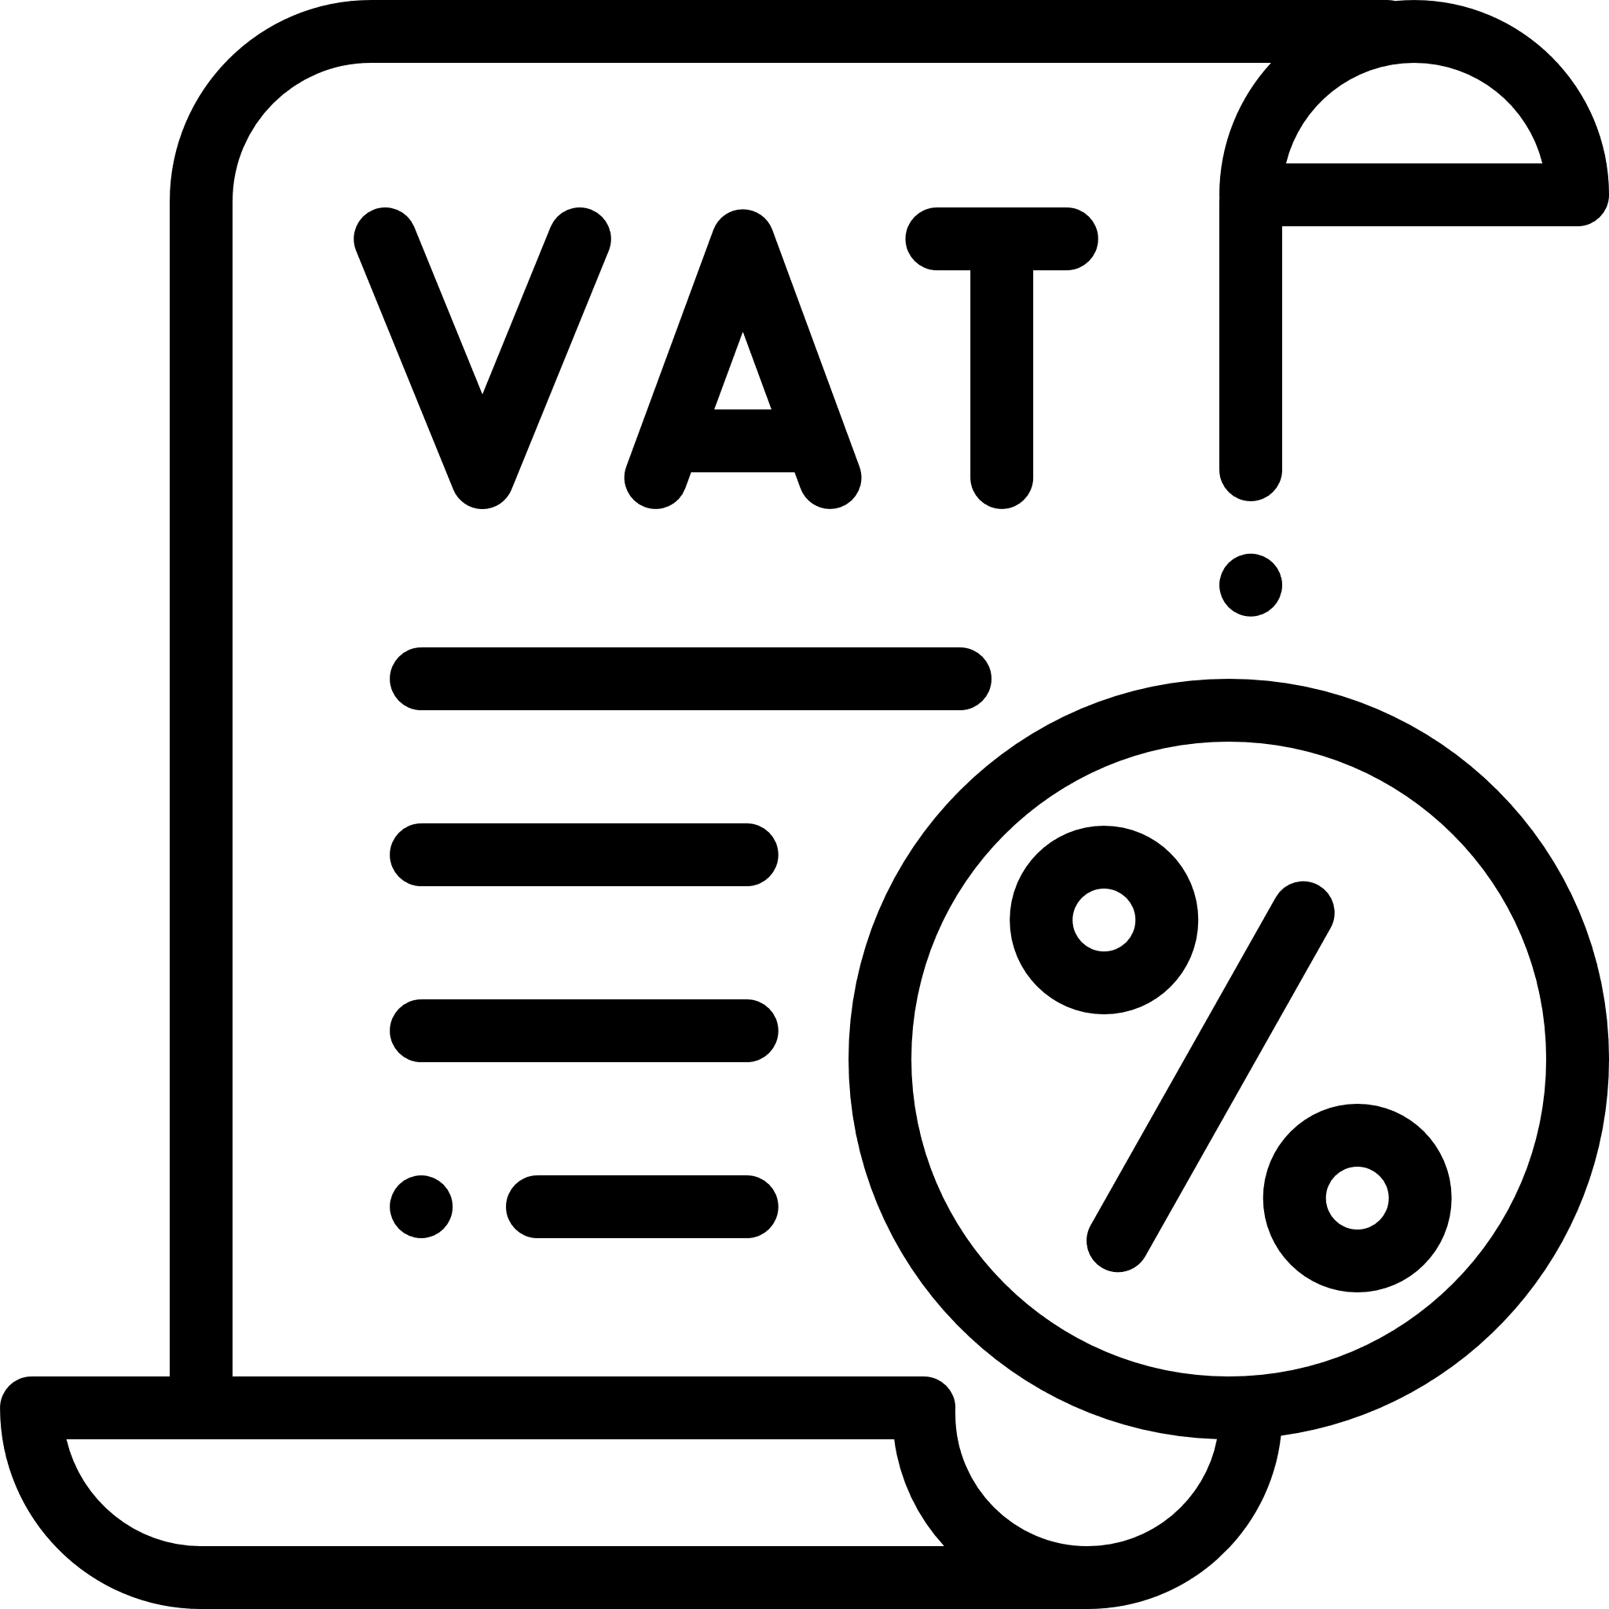
Nigeria: Key Areas of Reform Identified to Improve Revenue Mobilization
Value-added tax administration and plugging compliance gaps
Rationalizing tax expenditures in the corporate income tax
Personal income tax revenue raising measures and access to data
Property tax reforms; updating/completing property records
Excise reforms through policy measures
Reforms have potential to raise 4-6 trillion Naira ~7% of GDP
CONFIDENTIAL: NOT TO CIRCULATE

Slide 11
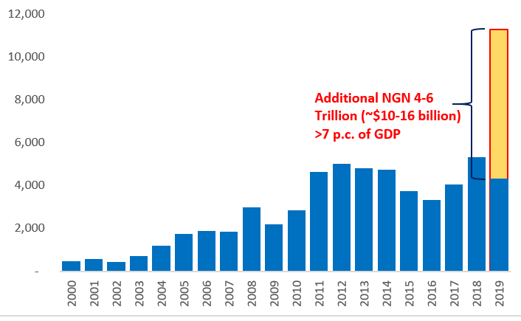
WB estimate: Nigeria’s Non-oil Revenue Potential Twice Current Collection, 2019
Best Case Scenario
1. Excise reforms through policy measures; 0.6% of GDP/NGN 930 billion from alcohol, cigarettes 0.4% of GDP/NGN 500-600 billion from airtime, petrol, diesel 2. Rationalizing CIT incentives; 0.7% of GDP/NGN 1,000 billion (more from addressing compliance gaps) 3. VAT administration reforms; 0.4% of GDP/NGN 600 billion from full implementation of rate increase 0.4 – 1.4% of GDP/NGN 800 billion to 2,000 billion from closing compliance gaps 0.2%+ of GDP/NGN 300 billion from petrol and diesel, taxation of cross-border digital 4. Property tax reforms in states; 0.2% of GDP/NGN 300 billion in the medium-to-long term
Potential Revenue Collection for 2019 (Billion NGN)
Note: The columns in blue capture actual oil and non-oil revenue collected. The column in orange captures additional revenue that we project could have been collected.
Source: https://www.firs.gov.ng/TaxStatisticsReports
CONFIDENTIAL: NOT TO CIRCULATE

Slide 12
THANK YOU

