Slide 1

Republic of South Sudan
NATIONAL REVENUE AUTHORITY
Tax Base Potential and Policy Options for Domestic Revenue Mobilization in South Sudan
Presented at the
1st National Economic Conference
By :
Hon. Athian Ding Athian
NRA Commissioner General
5 September, 2023

Slide 2
Outline of the Presentation
NRA Mandate
Medium Term Initiatives
NRA Asks
Comparative Analysis
Five-Year Strategic plan 2022-2027
Revenue Performance

Slide 3
1. NRA Mandate
Legal Framework for the Establishment of NRA
South Sudan National Revenue Authority Act, 2016
The Customs Service Act, 2013
The Import-Export Act, 2012
Taxation Act, 2009

Slide 4
The Philosopy
Vision
To be a Modern Tax Administration in Mobilizing Non-oil Revenue to Achieve a Tax to GDP Ratio of 6% by 2027.”
Mission
To Leverage on Digital Transformation and Highly Motivated Staff to Mobilise Non-oil Revenue for National Development.”

Slide 5
Core Values – TAP IT
Core Values
Transparency
Accountability
Integrity
Teamwork
Professionalism

Slide 6
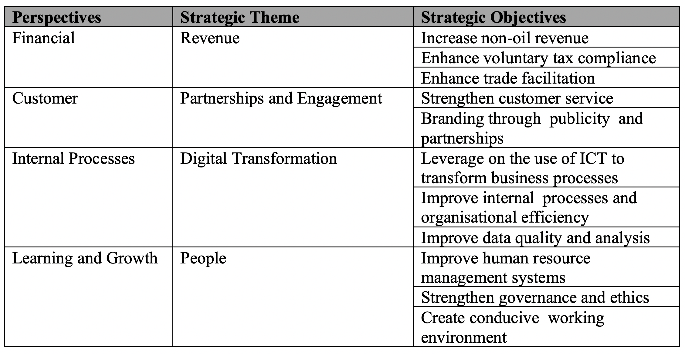
2. Five-Year Strategic plan 2022-2027
Strategic Objectives (11)
Notes:
BSC= Balanced Score

Slide 7
3. Revenue Performance in
FY 2021-2022, 2022-2023
Target for 2022/2023
Approved Resource Envelop for the FY 2022/2023 set the non-oil revenue target at SSP 117.035 billion
Implementation of the strategic initiatives under NRA 5-Year Strategic Plan to enhance performance by about 30%
NRA set internal working target of SSP 150.0 billion
Based on the NRA Tax Revenue Forecasting Model (NRFM)

Slide 8
Revenue Growth of 138 percent (SSP billion)

Slide 9
An Outturn of 163.9% against annual target

Slide 10
Customs versus Domestic

Slide 11
Real Revenue – no inflation

Slide 12
Revenue by tax heads
Personal Income Tax (PIT) contributed over 50% (SSP 90 billion) of total collection in Fiscal Year 2022-2023
The consumption taxes stood at about 30% of total revenue.
The rest came from others, including non-tax (fees and charges) revenue

Slide 13
Revenue Target: 2023-2024
Ongoing Implementation of the strategic initiatives and reforms to enhance performance by about 40% above government target.
NRA set internal working target of SSP 345 billion
Approved Resource Envelop for the FY 2023/2024 set the non-oil revenue target at SSP 245 billion

Slide 14
4. Comparative Analysis
Regional tax-to-GDP ratios in FY 2022-2023
Country | GDP (in Billions USD) | Tax-to-GDP Ratio
Tanzania | 67.84 | 16.3%
Rwanda | 11.07 | 15.08 %
Uganda | 40.53 | 13.9%
Kenya | 110.3 | 7.1 %
South Sudan | 5.3 | 3.6 %
Average |  | 12.22%
Note:
- South Sudan way below regional average
- Target of 4.5% in set FY 2023-2024
- 6% target achieveable in first 3 years of Strategic Plan Implementation

Slide 15
Regional tax-to-national budget ratios
Regional countries generate 50% - 70% of their National budget from domestic revenue mobilization.
Less than 20% in South Sudan

Slide 16
FY 2023-2024 Target
SSP 245 Billion (15% of the resource envelope but 10% of Expenditure)
Internal working target: SSP 346 Billion (16% of Expenditure)

Slide 17
5. Medium-term Initiatives
Widening the tax base
Strict implementation of Ministerial Order 02/2023 that nullifies all non-statutory exemptions.
New registration (increase no. of taxpayers)
Tax compliance (increase filing and payment)
Tax gap study (ascertain sectors for inclusion in the tax net)
Enhance automation/digitalization of tax administration

Slide 18
b. Policy reforms/measures
Legal framework needed:
- VAT (replace sales tax)
- Lotteries, gaming and betting taxation
- Digital (excise) tax stamps
- Tax administration procedures
- Tax tribunal/special court
- Alternative tax dispute resolution mechanism

Slide 19
6. NRA Asks
A whole government approach/support on tax reforms to achieve sustainable revenue mobilization (exemptions, employees management, funding etc.)
Timely drafting, passing and assent of all the laws by the Ministries of Finance, Justice, Cabinet, Parliament and Presidency.
Review SOFA/EPSA Agreement on exempting subcontractors
Public voluntary tax compliance (registration, filing and payment)

Slide 20
Asks…
State Governments and other entities involved in taxation to cooperate with NRA for efficient revenue collection (lessening tax burden on taxpayers through multiple collections).
Enhance Electronic System Integration
Effective anti-smuggling of goods and illicit trade
Reviewing SOFA/EPSA Agreements exempting all subcontractors from paying excise duties.

Slide 21
Thank you
Q&A

