Slide 1


THE NATIONAL ECONOMIC CONFERENCE
Under
The Theme
“ Towards a Diversified, Inclusive & Sustainable Economic Growth”
5th September 2023
Juba, Republic of South Sudan

Slide 2
PRESENTATION OUTLINE
Introduction
Crude Oil Productions and Sales Updates
Status of the Transitional Financial Agreement (TFA) with the Sudan.
Diversification of the Petroleum Sector
Challenges affecting the Petroleum Sector
Recommendations & Way Forward
Conclusion

Slide 3
INTRODUCTION

Slide 4
Main Highlights
Officially gained independence on 9-July-2011.
Estimated 5-billion bbl of oil reserves in South Sudan.
Was producing about 350,000 bbl/day prior to the 2013 political instability.
Currently producing an average of 166,000 bbl/day from Block 3, 7, Block 5A & Block 1,2 &4.
The estimated average Unit Production Cost (UPC) per Barrels in the Republic of South Sudan is $15 per Barrels of Crude Oil
More than 50% of country remains unexplored for oil reserves and no deep gas exploration has been conducted.
Oil represent > 85% of South Sudan’s GDP.
9/5/2023
4
Notes:
4
4

Slide 5
MANDATES OF THE MINISTRY OF PETROLEUM-(MoP).
OUR MISSION
“To ensure that the Ministry’s regulated facilities and activities are safe and secure, that the environment surrounding these facilities and activities is protected throughout their life-cycle”.
VISION
“To ensure that Petroleum activities are managed and developed in a way that contributes fully to economic development and human prosperity is ethical, efficient, transparent, accountable and according to environmentally, socially, and economically sustainable principles”.
CORE VALUES
“Good governance and leadership, professionalism, innovation, team work and collective responsibility and commitment to services”.

Slide 6
OUR MISSION
“To ensure that the Ministry’s regulated facilities and activities are safe and secure, that the environment surrounding these facilities and activities is protected throughout their life-cycle”.
VISION
“To ensure that Petroleum activities are managed and developed in a way that contributes fully to economic development and human prosperity is ethical, efficient, transparent, accountable and according to environmentally, socially, and economically sustainable principles”.
CORE VALUES
“Good governance and leadership, professionalism, innovation, team work and collective responsibility and commitment to services”.

Slide 7
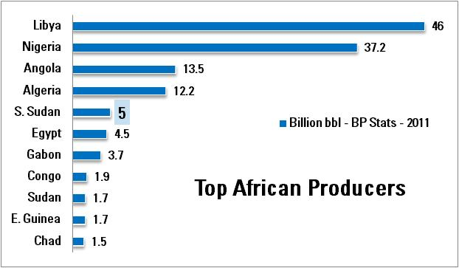
Estimated Crude Oil Reserves
9/5/2023
Sources. BP Statistical Review of World Energy, 2010 / 2013
7
Notes:
7
7

Slide 8
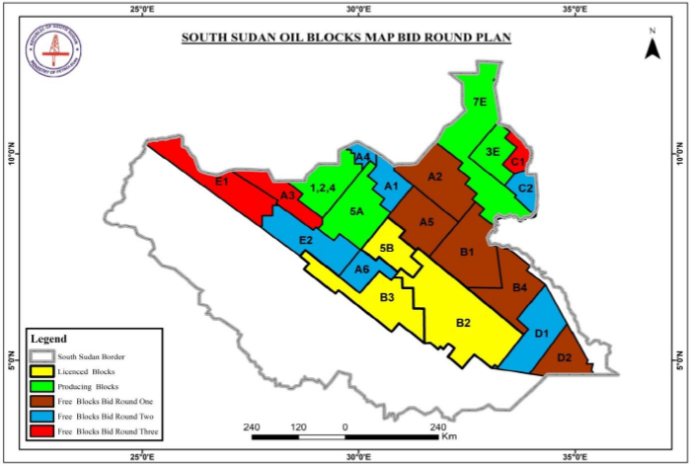
South Sudan Oil Blocks MAP
9/5/2023
8

Slide 9
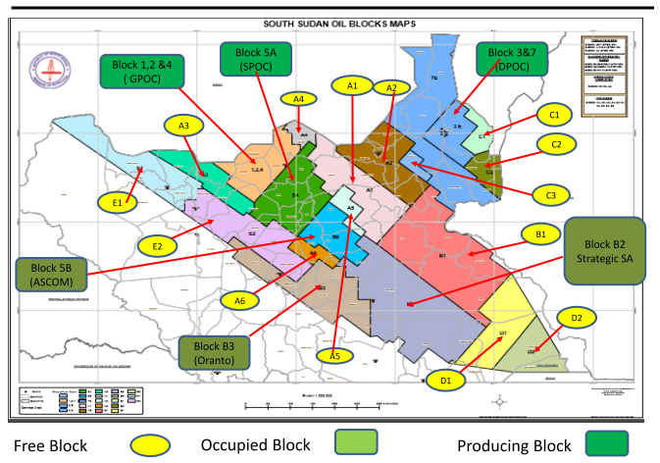

Slide 10
CRUDE OIL PRODUCTIONS AND SALES UPDATES.

Slide 11
South Sudan Petroleum Resources Distributions
Company /Blocks | Shareholders | PIIP (MMSTB) | RF (%) | EUR (MMSTB) | CUM. Production (MMSTB) | Remaining Reserve (MMSTB)
DPOC (3&7) | CNPC = 41% PETRONAS = 40% NILEPET = 8% SINOPEC = 6% SSTO = 5% | 5,747 | 23 | 1,321.81 | 752.00 | 569.81
GPOC (1,2 &4) | CNPC = 40% PETRONAS = 30% ONGC = 25% NILEPET = 5% | 2,526 | 34 | 858.84 | 675.00 | 183.84
SPOC (5A) | PETRONAS = 67.875% ONGC = 24.125% NILEPET = 8% | 2,655 | 8 | 212.40 | 47.00 | 165.40
ABBREVIATIONS:
PIIP : Petroleum Initially In Place
MMSTB : Million Stock Tank Barrels of Crude Oil
RF : Recovery Factor
EUR : Estimated Ultimate Recovery
CUM : Accumulative
9/5/2023

Slide 12
Well and Production Information
NO | INVESTMENT PARTNERS | PARTICIPATION INTEREST (%) | COMPANY NAME | BLOCK NAME | WELL STATUS | TOTAL (WELLS) | WELL CONTRIBUTION (%) | TOTAL DAILY GROSS PRODUCTION (Barrels/Day)
1 | CNPC | 41 | DPOC | Block 3 & 7 | TOTAL NUMBER OF WELLS | 926 | - | -
 | PETRONAS | 40 |  |  | Number of active/producing Wells | 648 | 69.97% | 102,045.00
 | NILEPET | 8 |  |  | Shutdown wells due to different challenges | 108 | 11.77% | -
 |  |  |  |  | Idle Wells | 74 | 7.99%
 | SINOPEC | 6
 | SSTO | 5 |  |  | Abandoned Wells | 86 | 9.29%
 |  |  |  |  | Relinquished Wells | 10 | 1.08%
2 | CNPC | 40 | GPOC | Block 1, 2 & 4 | TOTAL NUMBER OF WELLS | 289 | -
 | PETRONAS | 30 |  |  | Number of active/producing Wells | 132 | 46.32% | 56,789.07
 | ONGC | 25 |  |  | Shutdown wells due to different challenges | 67 | 23.51%
 |  |  |  |  | Idle Wells | 35 | 12.28%
 | NILEPET | 5 |  |  | Abandoned Wells | 55 | 19.30%
 |  |  |  |  | Relinquished Wells | 0 | -
3 | PETRONAS | 67.875 | SPOC | Block 5A | TOTAL NUMBER OF WELLS | 55
 |  |  |  |  | Number of active/producing Wells | 19 | 34.55% | 7,613.00
 | ONGC | 24.125 |  |  | Shutdown wells due to different challenges | 36 | 65.45%
 |  |  |  |  | Idle Wells | 0 | -
 | NILEPET | 8 |  |  | Abandoned Wells | 0 | -
 |  |  |  |  | Relinquished Wells | 0 | -
TOTAL NUMBER OF WELLS IN THE REPUBLIC OF SOUTH SUDAN |  |  |  |  |  |  |  | 1,270 Wells
Number of active/producing Wells (Crude Oil Production as of 30th August 2023 was 166,447.07 Barrels per day). (62.91%) |  |  |  |  |  |  |  | 799 Wells
Shutdown wells due to different challenges (16.70%) |  |  |  |  |  |  |  | 212 Wells
Idle Wells (8.60%) |  |  |  |  |  |  |  | 109 Wells
Abandoned Wells (11.10%) |  |  |  |  |  |  |  | 141 Wells
Relinquished Wells (0.80%). |  |  |  |  |  |  |  | 10 Wells

Slide 13
Contractual Obligations as per EPSAs.
Article 7.2(a) of the EPSA for Block 3 & 7 (DPOC):
Cost Oil = 45% of the Total Gross Production
Profit Oil = 55% of the Total Gross Production
  Government Entitlement = 60% of the Profit Oil
  Partners' Profit = 40% of the Profit Oil
Partners’ Entitlement = ( Partners' Profit + Cost Oil)
2023 Forecasted Daily Gross Production in Block 3 & 7 (DPOC) = 98,900 Barrels Per Day
Partners include CNPC, PETRONAS, NILEPET, ONGC, SSTO & SINOPEC.

Slide 14
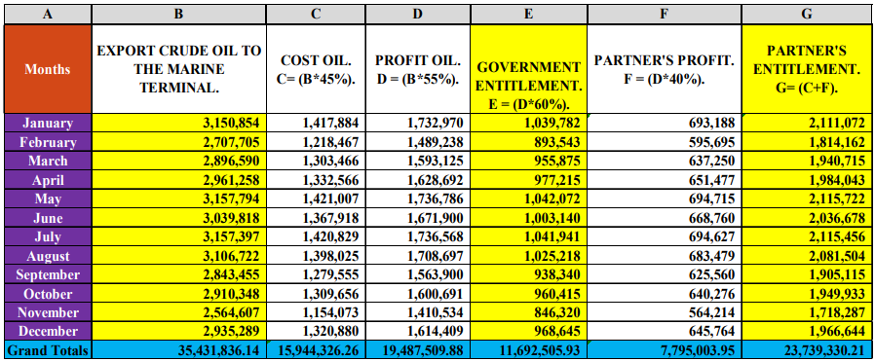
DPOC’s Actual Crude Oil Production for 2022

Slide 15
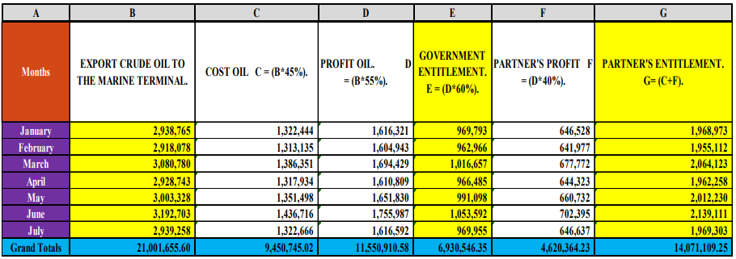
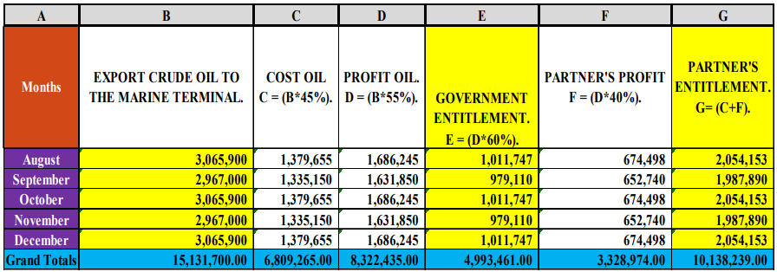
DPOC’s Actual Crude Oil Production for 2023 (Jan-Jul)
Forecasted DPOC’s Crude Oil Production for 2023 (Aug-Dec)

Slide 16
Contractual Obligations as per EPSAs.
Article 7.3.3 of the EPSA for Block 1, 2 & 4 (GPOC):
Cost Oil = 45% of the Total Gross Production
Profit Oil = 55% of the Total Gross Production
  Government Entitlement = 61.50% of the Profit Oil
  Partners' Profit = 38.50% of the Profit Oil
Partners’ Entitlement = ( Partners' Profit + Cost Oil)
2023 Forecasted Daily Gross Production in Block 1, 2 & 4 (GPOC) = 40,000 Barrels Per Day
Partners include CNPC, PETRONAS, NILEPET, ONGC, SSTO & SINOPEC.

Slide 17
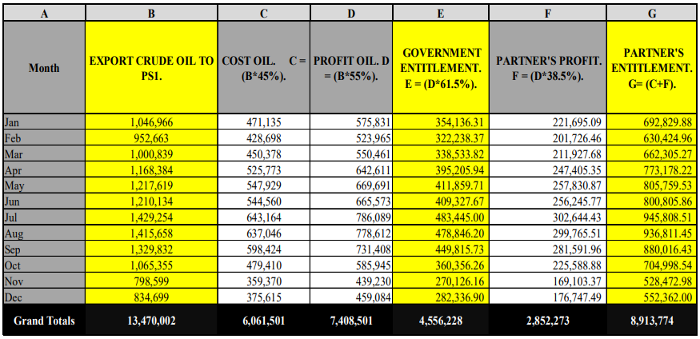
GPOC’s Actual Crude Oil Production for 2022

Slide 18
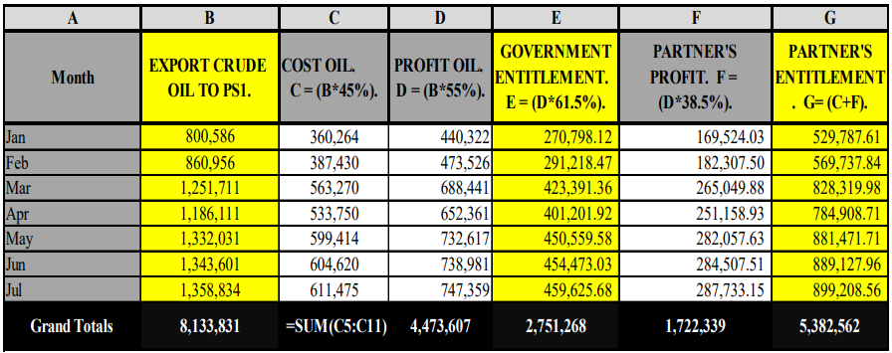
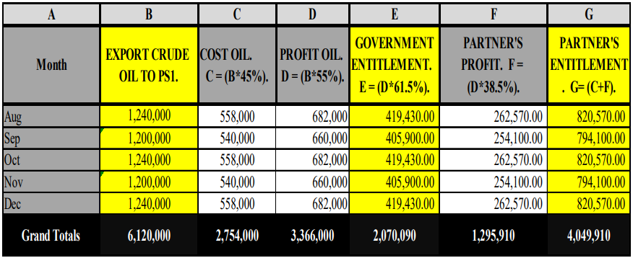
GPOC’s Actual Crude Oil Production for 2023 (Jan-Jul)
Forecasted GPOC’s Crude Oil Production for 2023 (Aug-Dec)

Slide 19
Contractual Obligations as per EPSAs.
Article 7.3.3 of the EPSA for Block 5A (SPOC):
Cost Oil = 40% of the Total Gross Production
Profit Oil = 60% of the Total Gross Production
  Government Entitlement = 71.50% of the Profit Oil
  Partners' Profit = 28.50% of the Profit Oil
Partners’ Entitlement = ( Partners' Profit + Cost Oil)
2023 Forecasted Daily Gross Production in Block 5A (SPOC) = 11,000 Barrels Per Day (5.87k in TJ & 5.13k bpd in Mala)
Partners include CNPC, PETRONAS, NILEPET, ONGC, SSTO & SINOPEC.

Slide 20
There was no Production in Jan 2022, Feb 2022 and Feb 2023 in Block 5A (SPOC’s oilfields) due to the below reasons.
A drastic drop in the landing temperature along the pipeline
The Continues Flood Situation
Other operational challenges

Slide 21
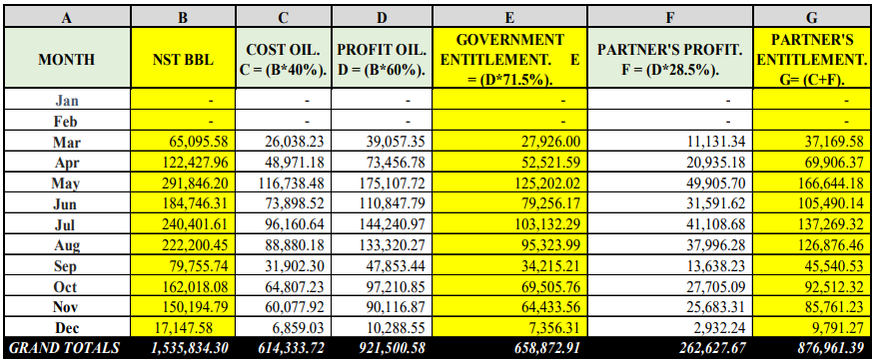
SPOC’s Actual Crude Oil Production for 2022

Slide 22
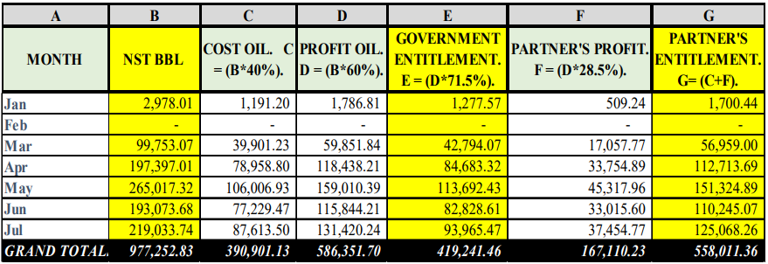
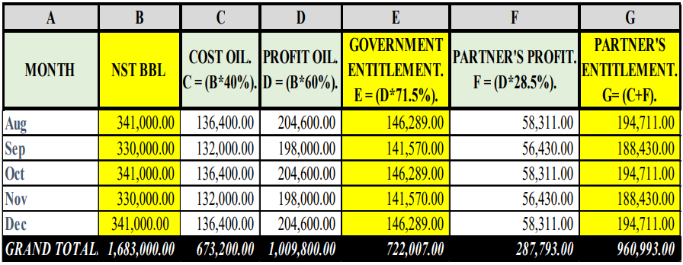
SPOC’s Actual Crude Oil Production for 2023 (Jan-Jul)
Forecasted SPOC’s Crude Oil Production for 2023 (Aug-Dec)

Slide 23
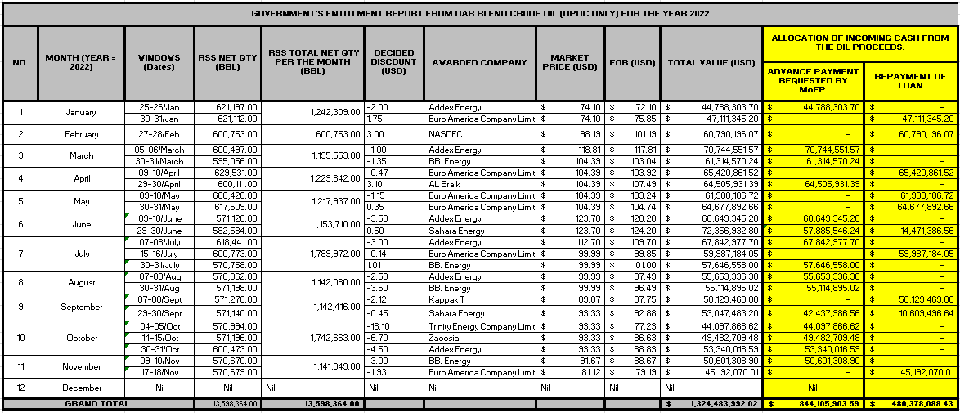
Crude Oil (Dar Blend) Sales Update for 2022.

Slide 24
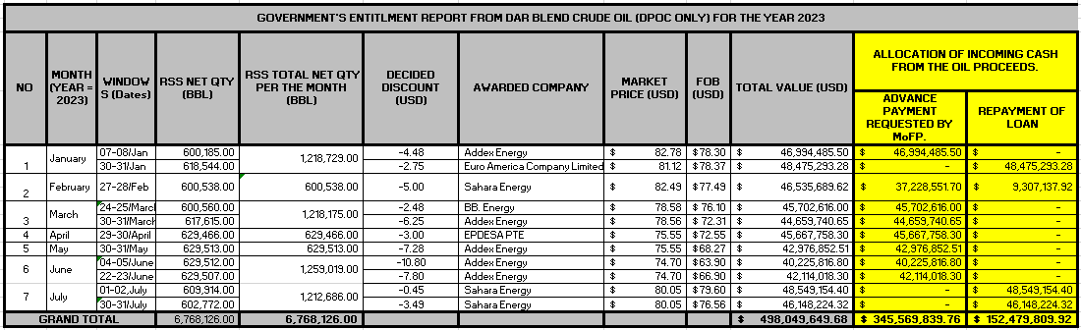
Crude Oil (Dar Blend) Sales Update for 2023 (Jan-Jul).

Slide 25
Summary of the Transactions ($$ & Barrels)
Projected Estimated Sales Revenue for 2023 (Jan –Dec) = $854M under the below main assumptions
Global Oil price stays above $80 per barrel
Daily Crude Oil (Dar Blend) Production remains above 100,000 bpd
No Major HSSE accident
No force majeure declaration
Continues CAPEX & OPEX expense activities
Main contributing factors to the drastic drop in the annual Sales Revenue in 2023 comparatively.
Global Oil price volatility
Drop in the daily Gross Crude Oil production
Sporadic industrial actions
Limited investment in the (CAPEX) Upstream Sector – (E&P)
Logistic challenges due to the political situation in the Republic of Sudan

Slide 26
STATUS OF THE TRANSITIONAL FINANCIAL AGREEMENT (TFA) WITH THE SUDAN.

Slide 27
The Fee (TFA) Amount due to the Republic of South Sudan from the Sudan for a period starting from March 2022 to July 2023 is 671,427,669.32 USD only (Six Hundred Seventy-One Million Four Hundred Twenty-Seven Thousand Six Hundred Sixty-Nine US Dollars and Thirty-Two cents only). This amount is subject to a final reconciliation between the two countries.
The Republic of the Sudan continues to take from the Republic of South Sudan a total of 28,000 Barrels of Crude Oil per Day as part of inland lifting program whereby 10,000 Barrels per day for the provision of power at the Kosti Power Plant (KPP) and 18,000 Barrels per day for the Khartoum Refinery Company Limited (KRC).

Slide 28
DIVERSIFICATION OF THE PETROLEUM SECTOR IN THE RSS.

Slide 29
Diversification of the Petroleum Sector.
  More new investments into the Upstream Sector
    Exploration Activities
    Production Activities
  Construction of a bankable Alternative Pipeline
    South Sudan to Lamu Port via Kenya (2000KM) at $5B as of 2013.
    South Sudan to Djibouti Port via Ethiopia (1500KM) at $4B as of 2013.
9/5/2023
29

Slide 30
Diversification of the Petroleum Sector (Cont’).
  Construction of a Scalable and Bankable Refinery
  Technological Transformation of the Petroleum Sector to ensure efficiency
  Invest in Wells’ Enhancement and Intervention Projects, in order to increase Crude Oil production
  Capacity building of Trainable, Coachable and Tradable Petroleum Carders
  Invest in the Oilfields’ Personnel and Asset Security, in order to indirectly increase production
9/5/2023
30

Slide 31
Diversification of the Petroleum Sector (Cont’).
  Invest in the transparency and accountability mechanism to help directly reduce the Unit Production Cost per barrel through accurate reporting, effective and efficient management of the operating companies.
  Invest on upgrading the existing Oilfield Processing Facilities (FPFs, CPFs, FSFs & OGMs).
  Renegotiate and Rewrite a Cash Generation Model of EPSAs.
9/5/2023
31

Slide 32
Diversification of the Petroleum Sector (Cont’).
Construction of a Tie-In Pipeline from Block 5A to Block 3 & 7.
Renegotiate the lifting of the Production Capping on Block 5A, in order to maximize the daily production rate
Construction of Depots and Fuel Distribution Networks for the local consumption
Establishment of Retailed and Fuel Stations across all the Ten States and Administrative Areas
9/5/2023
32

Slide 33
Diversification of the Petroleum Sector (Cont’).
Establishment of a Central Laboratory.
Establishment of a Petroleum Vocational Training Centre.
Commercialize the empty oilfield blocks for new investment in the upstream Sector.
Construction and Rehabilitation of all Infields, Interstates’ and Regional Roads and Ports, to ensure easy accessibility to and fro the oilfields and country.
9/5/2023
33

Slide 34
CHALLENGES AFFECTING THE PETROLEUM SECTOR IN THE RSS.

Slide 35
OPERATIONAL CHALLENGES
The Republic of South Sudan continues to experience an annual drop in the daily average Gross Crude Oil production by an estimated figure of 20%, due to the below operational challenges, and these challenges are considered a business opportunities for investors and diversifications.
  High Water Production
  Sand Production
  H2S Production
  Aging Oilfield Facilities
  Produced Water Management
  Continues depletion of Reservoir Pressure
  Limited qualified local workforce
  Continues Flood Situation
  Capping of Block 5A.
9/5/2023
35

Slide 36
GEOPOLITICAL CHALLENGES
  Global Oil price volatility
  Transition into Greener, Affordable and sustainable Energy Sources by 2030 as per COP 26 strategic vision.
  A very high and unreasonable Processing, Transportation and Transit fee per barrel being charged by the Republic of Sudan.
  Volatile Geopolitical situation within the region.
9/5/2023
36

Slide 37
GOVERANCE AND POLICY FRAMEWORK CHALLENGES
  Limited Petroleum related Laws and Regulations
  Limited Petroleum related Standards, Policies, and Procedures
  Serious resistance to the implementation of the existing Policies and Regulations
  Lack of Public and Official awareness on the mandates of the Ministry of Petroleum
9/5/2023
37

Slide 38
RECOMMENDATIONS
AND
WAY FORWAD.

Slide 39
Diversifications of the National Economy.
  Invest in all the mentioned activities for the diversification of the Petroleum Sector
  Invest the Oil Proceeds for the diversifications of the other crucial Sectors towards Diversified, Inclusive, & Sustainable Economic growth.
    Agriculture and Allied Sector
    Education, Health & Other Services Sector
    Information Sector
    Extractive Industry Sector
    Construction Sector
    Leisure and Hospitality Sector
    Manufacturing Sector
    Professional and Business Services Sector
    Trade, Transportation and Utility Sector
9/5/2023
39

Slide 40
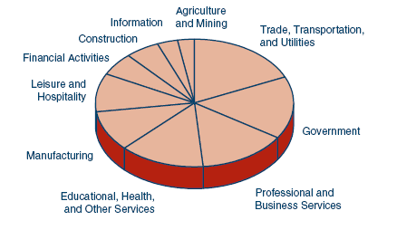
Elements of a well-Functioning, Balanced, and Healthy Diversified Economy.

Slide 41
CONCLUSION.

Slide 42
The World is transiting into Greener Energy Sources by 2050 in accordance with the aspiration and vision of COP 26, The scary part is that the future of our Petroleum sector is becoming very uncertain and we must start planning for time when our petroleum products will no longer be the most sought after commodity in the market. Meaning, there will soon be time within the next 25-30 years whereby our petroleum products will no longer be needed in the market.

Slide 43
“In anticipation of the World’s aspiration to abandoned Fusel Fuel and transit towards the Greener Energy Sources by 2050, the Ministry of Petroleum continues to advocate for the diversification of the National Economy, through effective and efficient management and Smart investment of the Oil Proceeds into other revenue generation Sectors. This will ensure a more Diversified, Inclusive, Balance and Sustainable Economic Growth in our Beloved Country”.

Slide 44
At MoP,
“ We believe and advocate for the diversification of our National Economy”.

