Slide 1
Revitalizing Agriculture and Generating Local Economic Integration: The South Sudan Food System and the Outcomes of Sub-National and the South Sudan Sub-National and National Food Systems Dialogue
First National Economic Conference,04-08 September,2023,Freedom
Hall/Radisson Blu,Juba-South Sudan
Michael Roberto Kenyi Legge
Assist Prof of Agriculture and Food Security ,SNRES,University of Juba
Tel:+211(0)925772319/E-M:michaelrobertokenyi@gmail.com

Slide 2
PRESENTATION OUTLINE
INTRODUCTION
AGROECOLOGY
PROBLEM STATEMENT
APPROACH
OUTCOME
THE WAYFORWARD

Slide 3
INTRODUCTION
South Sudan is a land-linked or connected country, attained independence in 2011,currently is divided into ten states and three administrative areas
Estimated population by mid-2022 of 12.5 million with density of 13 and 18 people per sq.km (FAO/WFP/CFSAM,2023)
95% of South Sudan’s 6509,000 km² is suitable for agriculture, 50% is prime agriculture land with soils and climate suitable for a variety of food and cash crops.
Only 4% of the prime land is under cultivation (mostly rain-fed),low yield and poduction of cereals (Food)
29% (644,329 sq km) of the land is under forest cover – woodlands covering some 208,157 square kilometers
219,228 square kilometers covered by trees and another 257,236 square kilometers or 40% covered by shrubs rich in timber and non-timber resources

Slide 4
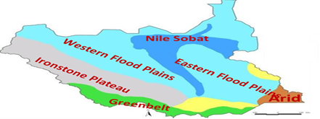
AGROECOLOGY OF SOUTH SUDAN
South Sudan has seven Agro-Ecological Zones including:
1.Greenbelt
2.Hills and mountains
3.Semi-arid
4.Ironstone plateau
5.Nile Sobat corridor
6.Eastern and
7.Western flood plains
Figure 1: Illustrating Agro-Ecological Zones Map of South Sudan

Slide 5
80% of the population in South Sudan is rural, with 45% agro-pastoralist, 35% agrarian, 12% fishermen, and 8% others
South Sudan has the sixth biggest herd in Africa (11.7 cattle, 12.3 m sheep, and 12.6 m goats),
Potential for fish harvest is up to 300k tons/year.
Most of the country receives 750–1,000 mm of rain annually from March to November with short dry spell in June,South and west receives slightly more with wet and dry seasons(1,000–1,500mm)
North and south eastern regions less (500–750mm) falling to less than 500 mm in the extreme southeast
South Sudan experiences a tropical climate,temperature averages are normally above 25 degree celcius
The average elevation range of South Sudan is 3,362 m(11,031 ft)

Slide 6
PROBLEM STATEMENT
Worldwide 2.3billion(11.7%) are food insecure and in Africa 795 million severely food insecure
Poverty,conflict,climatic shocks,low production,economic crises and phhysical insecurity are perceived as major drivers of food insecurity and vulnerability
60% of calories & proteins consumed by humans today comes from only 3-plant species; maize, wheat & rice and 75% of our food supply comes from only 12 plants and 5 animal species (AWARD,2023)
65% of the population food insecure in South Sudan(IPC,2022)
63 % women engaged in agriculture in South Sudan (MAFS,2023)
72% of the population are youth,mostly unemployed in South Sudan
20% of seeds supplied by humanitarian agencies(FAO,2018)
Inadequate agroforestry inputs,veterinary drugs and fishing supplies
Lack of understanding of Water-Energy-Food Nexus
Lack of understanding the factors which arise during the implementation of policies

Slide 7
Table 1:South Sudan – Estimated (traditional sector) cereal harvested area, yield, Production, Consumption and Balance,2022, ( FAO/WFP/CFSAM, 2023)
 |  | 2022
State/Administrative | Cereal Area | Gross yield | Gross cereal | Net cereal
Area/County
 | (Hectares) | (Tonnes/ Hectares | Production(Tonnes) | Production (Tonnes)
1.Central Equatoria | 82 619 | 1.38 | 113 787 | 91 030
2.Eastern Equatoria | 133 950 | 1.17 | 156 903 | 125 522
3.Jonglei | 46 728 | 0.72 | 33 467 | 26 774
4.Pibor Administrative Area | 16 650 | 0.85 | 14 165 | 11 332
5.Lakes | 161 687 | 1.18 | 190 458 | 152 367
6.Northern Bahr el Ghazal | 166 842 | 0.87 | 145 879 | 116 703
7.Unity | 12 434 | 0.66 | 8 162 | 6 530
8.Ruweng Administrative Area | 4 479 | 0.92 | 4 102 | 3 281
9.Upper Nile | 48 454 | 0.67 | 32 490 | 25 992
10.Western Bahr el Ghazal | 64 264 | 1.26 | 80 852 | 64 682
11.Warrap | 179 533 | 0.89 | 160 397 | 128 318
12.Abyei Administrative Area | 7 964 | 0.90 | 7 168 | 5 734
Western Equatoria | 153 319 | 1.45 | 222 427 | 177 942
TOTAL | 1 078 923 | 1.08 | 1 170 259 | 936 207

Slide 8
Table 2: Cereal Area and Production Estimates of the Mechanized Subsector,202,FAO/WFP/CFSAM,2023
Location | Number of Tractors | Harvested Area (Hectares) | Yields (Tonnes/Hectares) | Production (Tonnes)
Upper Nile (Renk and Melut) | 630 | 192 700 | 1.00 | 192 700
Ton Chol | 4 | 147 | 0.86 | 126
Aweil-Danga | 1 | 34 | 0.40 | 14
Aweil Rice | 2 working tractors + renting | 210 | 1.00 | 210
Udhum (sorghum) | - | 135 | 0.86 | 136
TOTAL | 637 | 198 196 | 0.88 | 193 186

Slide 9
Table 3: Estimated Quantity Of Ox-Ploughs , Tractors ,and Hire Rate/Feddan in Selected States and Counties During The Agricultural Season 2021/2022 (FAO/WFP/CFSAM,2022)
State/County | Ox-ploughs |  |  | Tractors
 | Quantity | Hire Rate/Feddan |  | Quantity | Hire Rate /Feddan
 | 2022 | 2021 | 2022 | 2022 | 2021 | 2022
1.Lakes state
1.1 Aweial County | NA | 5,000 | 7,000 | NA | NA | NA
1.2 Cueibet County | NA | 7,000 | 10,000 | NA | NA | NA
1.3Rumbek North, Centre and East Counties | NA | 10,000 | 15,000 | NA | NA | NA
2.Warrap State | 2,246 | 15,000 | 25,000 | 38 (Functional) | 40,000 | 35,000

Slide 10
APPROACH
Explanatory research design enabled exploration of causal relationships
Understanding of the underlying causes of low agricultural production, poor local economic integration and its impact on food security and livelihoods as well as economic growth

Slide 11
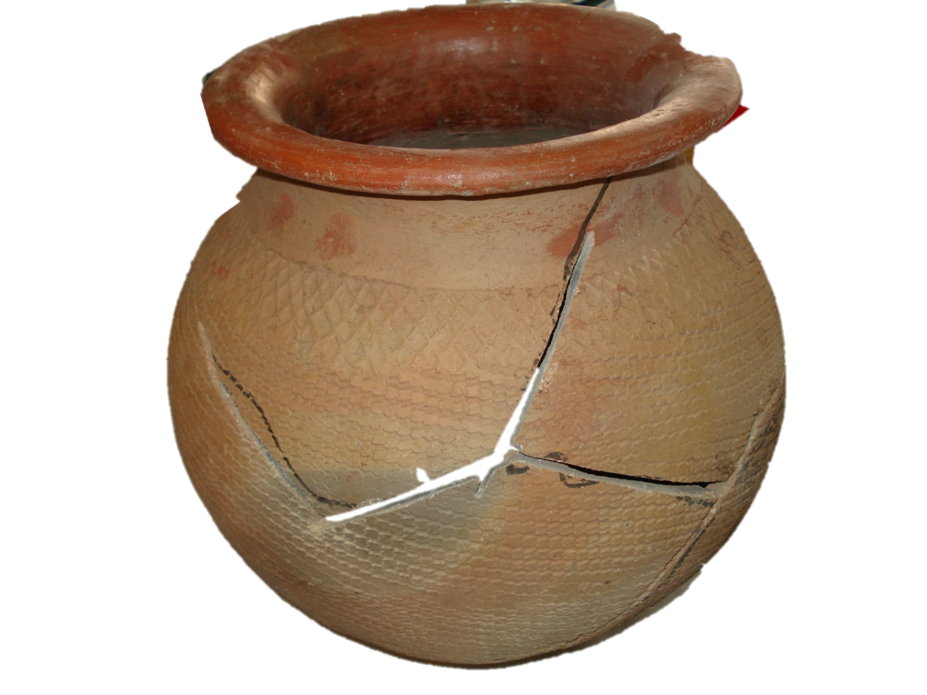
OUTCOME
The African food pot in South Sudan has been broken, characterized by over-reliance on an imported agricultural products and food assistance
Unsustainable livelihoods(poverty), poor prioriitized policy;weak institutional framework and architecture, Underdeveloped human capital, lack of investment in agriculture, limited infrastructure,lack of mutual accountability
Contributed to the food broken pot, constrained revitalizing agriculture and absence of generating local economy integration

Slide 12
The African food pot in South Sudan has been broken, characterized by an imported agricultural products and overdependence on food assistance
Unsustainable livelihoods(poverty), poor prioriitized policy;weak institutional framework and architecture, Underdeveloped human capital, lack of investment in agriculture, limited infrastructure,lack of mutual accountability
Contributed to the food broken pot, constrained revitalizing agriculture and absence of generating local economy integration

Slide 13
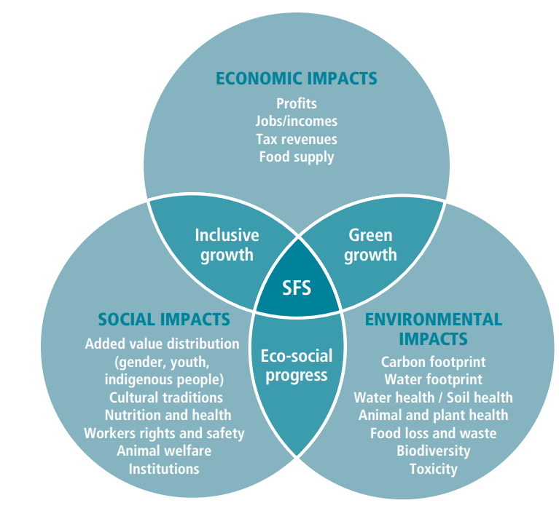
FOOD SYSTEM
Food system is the entire range of actors and their interlinked value-adding activities involved in the production, aggregation, processing, distribution, consumption and disposal of food products that originate from agriculture, apiculture, forestry or fisheries, and parts of the broader economic, societal and natural environments in which they are embedded (FAO, 2018).
A sustainable food system-based developed must yield the three broad dimensions of impacts as illustrated in Figure 2.
Figure 2:Sustainable Food System Framework
Source: FAO, 2018

Slide 14

FOOD SECURITY
Figure 3: Four Dimensions of Food Security

Slide 15
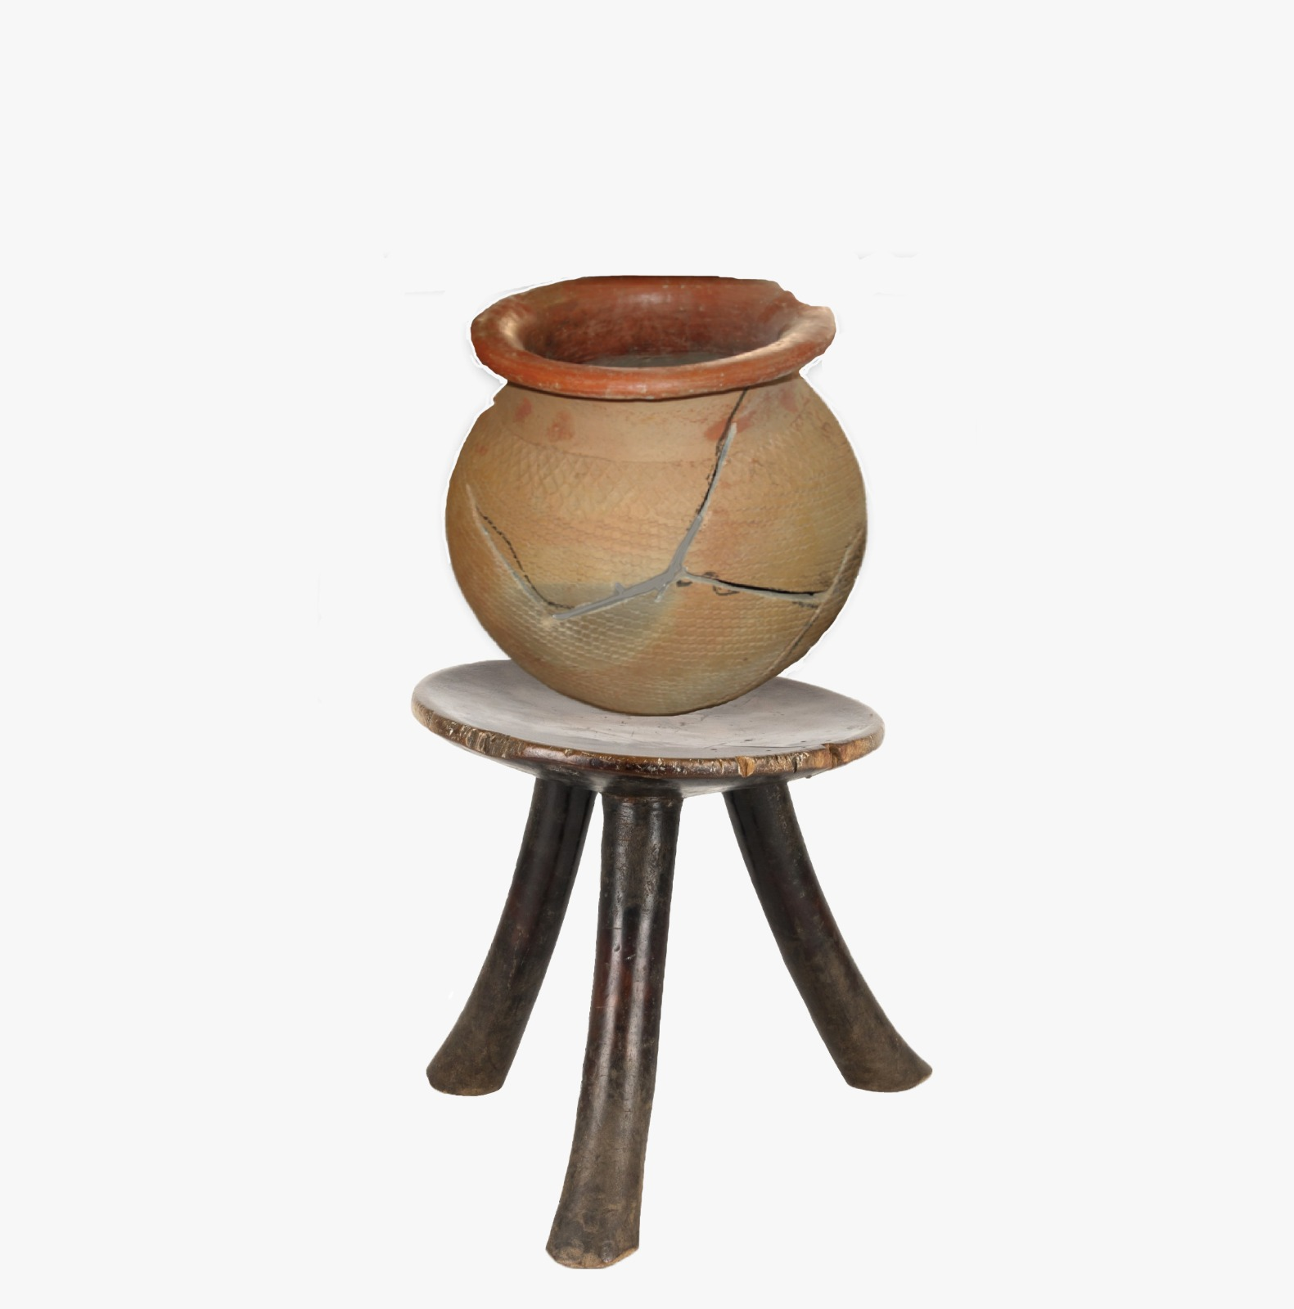
MUTUALLY REINFORCING ELEMENTS FOR REBUILDING THE AFRICAN SOUTH SUDANESE FOOD SYSTEM POT
Policy system consists of 3 mutually reinforcing elements: 1) Prioritized policy
2) Institutional Architecture and 3) Mutual Accountability…
Figure 4:Three Mutually Reinforcinng Elements

Slide 16
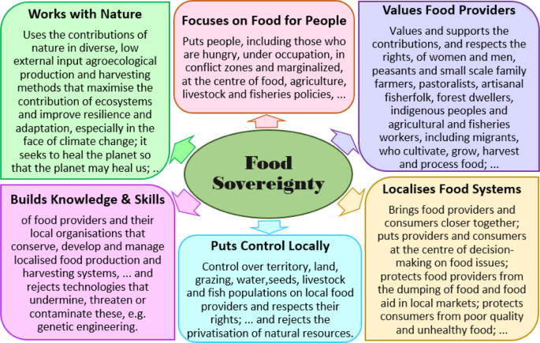
THE WAY FORWARD
FOOD SOVEREIGNTY
Figure 5 : Showing Six Pillars of Food Sovereignty
Source:Abeysekera,A,B,Punyawardadena,BVR,
Marambe,B etal,(2019)

Slide 17
POLICY RECOMMENDATIONS
Peace and security are “conditio sine quo non” for any progress in Agrocultural Transformation and Natural Resources sustained utilization
Adoption of CAADP Maputu declaration and Malabo commitments for allocation of at least 10 of national budget for agricultural growth to 6% annually
Review of National Agriculture and Livestock Extension Policy(NALEP
Reappraisal of Comprehensive Agriculture Master Plan(CAMP)
Reassessment of Irrigation Development Master Plan(IDMP)

Slide 18
Assessement of Zonal Efforts for Agricultural Transformation(ZEAT)
Popularization of Animal Traction,Ox-ploughing or Draught Animal Power(DAP)
Design of programmes for plant and animal genetic resources
Urge donors to assit in critical review of 11 agricultural sectoral policies and align their funding to support the 110 CAMP projects
Design of South Sudan Post-harvest Loss Management Strategy
Adoption of sustainable homestead farming model
Development of agroecology policy for food sovereignty, agroentrepreneurship and territorial markets
Development of Gender and Youth Responsive Agriculture Policy
Promotion of agricultural and biotrade for natural honey ,Shea butter,hides and skins, oileeds, vegtables and fruits,Gum arabic(NEIS,2023)

Slide 19
Support agricultural research and development for improved technologies and techniques
Support establishment and strengthening County Departments of Agriculture, Livestock, Forestry,Fisheries and Agricultural Economics and Statistics recruiting and deploying university graduates
Support Public Private Dialogue Mechanism at National,State and County levels for negotions for reduction to minimum or exemption of taxes levied on imported agricultural inputs and agricultural exports
Domestication and implementation of SDG 2, AU 2063 agenda and REC resolutions, strategies, programmes and projects.
For example,AU DECISION ON ORGANIC FARMING .EX.CL/631(XVIII) in 2010

Slide 20
“SOUTH SUDAN IS THE LARGEST ORGANIC FARM IN THE WORLD”
DR JOHN GARANGE DE MABIOR,2000
THANK YOU
QUESTIONS AND ANSWERS

