Slide 1
1st National Economic conference
‘’Towards a diversified, inclusive and sustainable economic growth’’
4 – 8 September, 2023
Ministry of Finance and Planning, Republic of South Sudan
Physical Capital Formation: Focusing on Infrastructure and Energy (Hydropower).
Presented by:
Eng. Emmanuel Lokiri Komuri

Slide 2
1st National Economic conference
‘’Towards a diversified, inclusive and sustainable economic growth’’
Contents
Introduction
Definitions
Tariffs and electricity coverage
Hydropower Potentials of South Sudan
Studies carried out for Major, Medium & Mini hydropower projects
Capacities
Development options
recommendations

Slide 3
Definitions
Infrastructure and Energy infrastructure is key for any modern and growing society.
What is Infrastructure?
Infrastructure is the basic physical and organisational structure and facilities and capital equipment needed for the functioning of a country (or society or enterprise).
They include communication equipment, communication systems;
Fire station, firehouse;
Oil & Gas systems;
Power system (generation, transmission & distribution);
Public works (school system, hospitals, public buildings, recreational facilities, malls…etec)
Sewage system & sewerage works;
Transportation system (roads, bridges, airports, railways….);
Water systems (water supply, water treatment, pump stations, irrigation works, water impoundment structures…..)
Communication systems (ICT, data centres..)
Stores; …..
What is energy?
Energy in physics is defined as the capacity for doing work. It may exist in potential, kinetic, thermal, electrical, chemical, and nuclear or other various forms.
Hydropower, or hydroelectric power is one of the oldest and largest sources of renewable energy, which uses the flow of moving water to generate electricity. In 2020 hydropower supplied 17% of global electricity generation, the third largest after coal and natural gas (according to the International Energy Agency’s hydropower special market report).

Slide 4
South Sudan population has low access to electricity & electricity tariffs are expensive:
Currently, South Sudan has the highest electricity tariffs in the East Africa Community (average 40 cents/KWh) due to reliance on expensive source of energy that is produced from diesel fuel generators and heavy fuel oil (HFO).
South Sudan is ranked as the least electrified country in Africa, standing at number one out of ten least electrified countries.
Only 1% of the population has access to the national electricity grid. This means that approximately 130,000 people have access to electricity out of the estimated population of approx. 13 million population.
For the access to electricity to rise above the 1%, the country needs to build power stations especially hydropower plants, construct transmission lines and distribution networks.
As the matter of fact, every productive sector of the economy relies on the provision of electrical energy,
Higher electricity tariffs will discourage investment in the industrial sector. It will also make electricity not affordable to low income sector of the population. Electricity is not any more a luxury but a necessity which plays a vital role in social and economic development as it is a critical factor of production whose cost directly impacts other services and the competitiveness of enterprises.
South Sudan should therefore, embarks to expand the generation capacity by developing the hydropower potentials to meet the projected power demand of 1185MW by 2030 (SMEC 2010 forecast). In addition the country should also embark to expand the national transmission and distribution grid to link all ten state capitals and to connect to the grids of Ethiopia, Kenya and Uganda and or the East African Power Pool (EAPP); increase the access to electricity especially in the urban towns.

Slide 5
Hydropower potentials of the republic of South Sudan
The Republic of South Sudan is endowed with a number of potential major hydropower sites which are all situated on the Bahr El Jebel River. The identified hydropower sites are located in Central & Eastern Equatoria States south of Juba and these stretches along the Bahr el jebel stretch of the Nile with different capacity from Juba, Bedden, Shukoli, Lakki and ending at the Grand Fula in Nimule near the Ugandan border.
In addition to the major hydropower sites along Bahr el Jebel, there are several sites along some major tributaries and rivers, that can be utilized for development of medium, small, mini and micro hydropower in the future and they can contribute hydro-electricity to the local grid.
The medium and mini hydropower sites which are of interest are located on the Sue River and River Kinyeti respectively.

Slide 6
Location of Hydropower sites:

Slide 7
Location of major hydropower projects

Slide 8
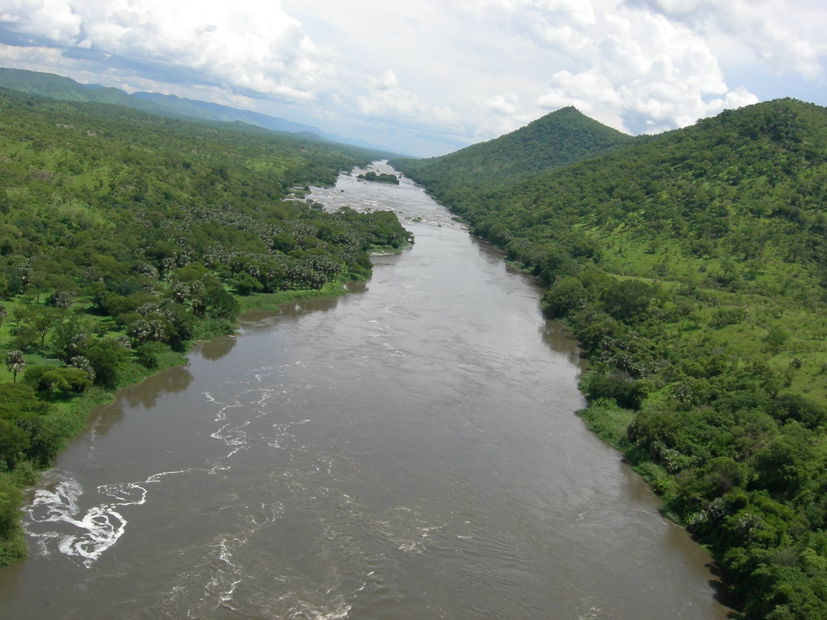
Location of Grand Fula

Slide 9
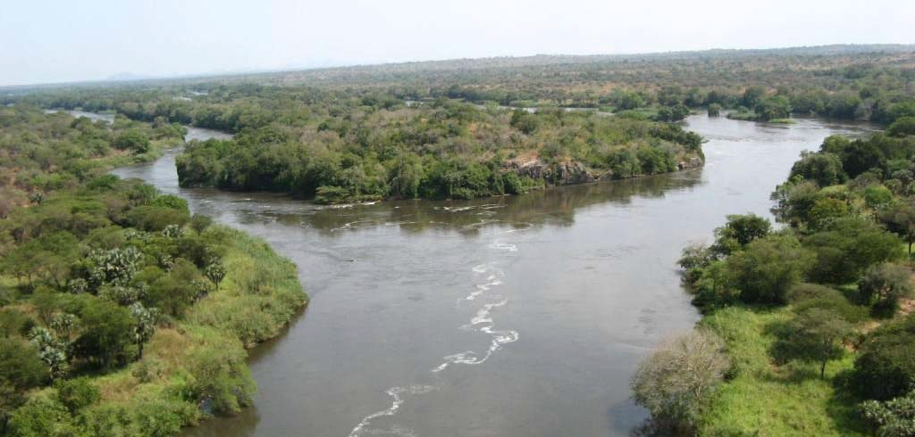
Location of Bedden HPP
BEDDEN DAM SITE, THE CENTERLINE CROSSES THE MAIN ISLAND

Slide 10
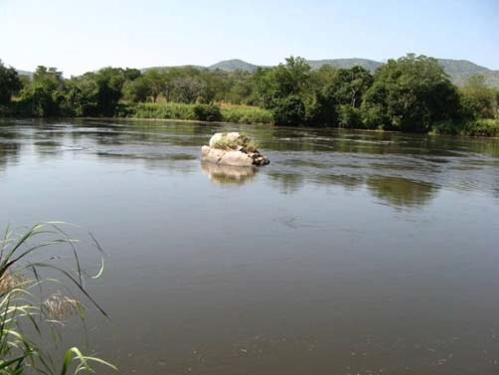
Location of Lakki HPP
VIEW ACROSS RIVER NEAR LAKKI DAM CENTERLINE

Slide 11
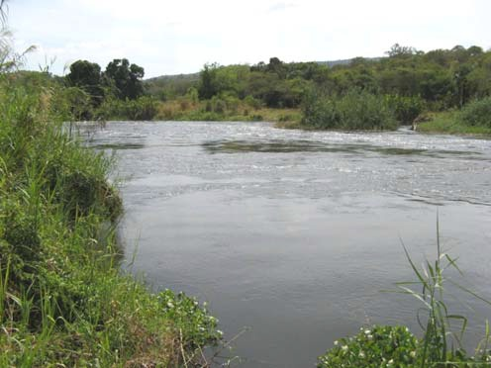
Location of Shukoli view of riverchannel from right bank downstream of centerline

Slide 12
Location of Medium & Micro HPP:
1. Location of Juba HPP (Juba barrage)

Slide 13
Location of Medium & Micro HPP:
2. Location of Kinyeti HPP

Slide 14
Location of Medium & Micro HPP:
3. Location of Sue HPP

Slide 15
Studies carried out for the HPP
(Major HPP)
The Dam Implementation Unit (DIU) of the Ministry of Electricity and Dams (formerly of the Presidency of the Republic of the Sudan), had engaged SMEC International Pty Ltd to provide consulting services for Bedden, Lakki, Shukoli and Fula Hydropower Projects (collectively known as Bahr el-Jebel Hydro Power Project or the Project). The contract was awarded and signed on 27 August 2008 in Juba. The signing ceremony was witnessed by the former president of the Sudan, Omer Hassan Ahmed El Beshir and the President of South Sudan, H.E Salva Kiir Miyardit.
The studies were later completed in 2010.
The studies for four major hydropower sites located along the Bahr el Jebel were commissioned by the Dams Implementation under the then government of the Sudan. The studies were done comprehensively to the level of Detailed Feasibility Studies, ESIA & RAP, design & tender documents.
The Detailed Feasibility studies supported by:
Detailed bathymetric surveys, orthophoto mapping & Lidar (IGN France)
Geological studies (Geotracks in association with Dr. Tilib)
Geotechnical investigations (NCGI),
Seismic studies (CARRIE of Germany)
Topographic surveys (Photo Map).
Seismic hazard analysis and design parameters (British Geological Survey)
PMP estimates for the catchment from Lake Albert outlet to Juba (UK Meteorology Office)
ESIA and RAP studies were completed, public consultation was also conducted then.
Tender Design & Tender Documents were completed and Bedden was tendered

Slide 16
Studies for the Medium & mini HPP
(Juba, Sue & Kinyeti)
on August 27, 2008, the contract for consulting services for the feasibility studies and design for Juba, Sue and Kinyeti Hydropower Projects (a contract for “Engineering Consulting Services for Review of Previous Studies & data, Pre-Feasibility and Feasibility Studies, Tender Design and Tender Documents for Juba, Sue & Kinyeti Hydropower Projects in Southern Sudan” was signed in Juba between the Dams Implementation Unit (DIU), of the Presidency of the Republic of Sudan, and SINOHYDRO with YREC (Yellow River Engineering Consulting Co. Ltd) as the designer.
The studies for the medium and mini hydropower sites located along the Bahr el Jebel, Sue and Kinyeti were commissioned by the Dams Implementation under the then government of the Sudan, the studies were done comprehensively to the level of Detailed Feasibility Studies, ESIA & RAP, design & tender documents

Slide 17
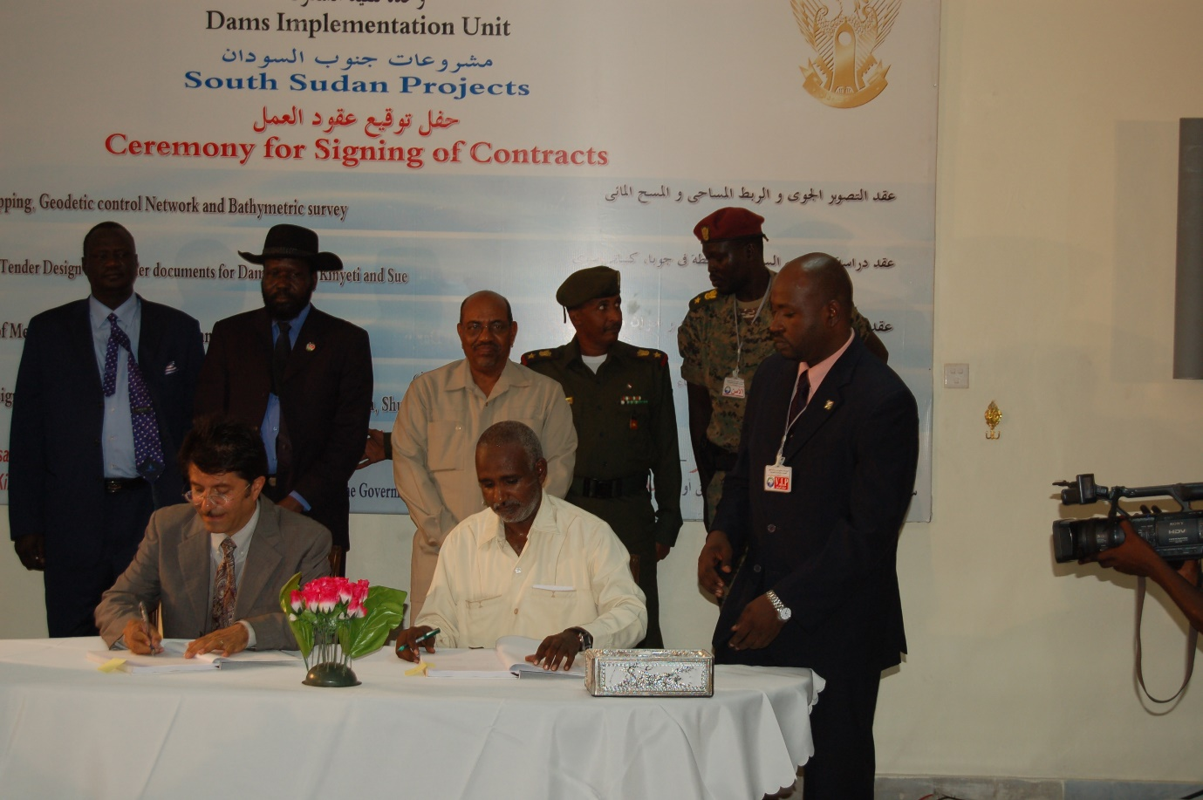
Ceremony for signing of the Southern Sudan HPP
(extracts)

Slide 18
Bahr el Jebel hydropower plant potentials
(capacities, FSL & Costs)
 | Fula | Shukoli | Lakki | Bedden
Installed capacity (MW) | 1092 (6x182MW) | 291 (6x48.5MW) | 456 (4x76MW) | 780 (4x130MW)
Distance from Uganda border (km) | 33 | 46 | 71 | 136
Full supply Level (Masl) | 610 | 552 | 536 | 510
Turbine Type | Vertical Francis turbine | Vertical Karplan | Semi-Spiral vertical Kaplan | Kaplan Turbines
Estimated cost (2010 estimates) | 1.558 billion USD | 820.22 Million USD | 1.025 billion USD | 1.452 billion USD

Slide 19
Medium & mini HPP potentials
(Juba, Sue & Kinyetti)
 | Juba HPP | Sue HPP | Kinyeti run of the river HPP | Kaia
Installed capacity (MW) | 120MW | 15MW | 1.95 MW | 13.5MW
Estimated Cost (2010) | 452.72 million USD | 279.525 million USD | 17.125 million UDS | Bonifica 1983

Slide 20
Maximum demand forecast for South Sudan
(SMEC 2010)
State | 2010 MW | 2015 MW | 2020 MW | 2025 MW | 2030 MW
Upper Nile | 6 | 16 | 43 | 69 | 138
Jonglei | 7 | 17 | 38 | 63 | 130
Unity | 3 | 7 | 17 | 28 | 57
Warap | 6 | 17 | 34 | 65 | 125
Northern Bahr El Ghazal | 4 | 14 | 27 | 52 | 99
Western Bahr El Ghazal | 2 | 5 | 11 | 17 | 37
Lakes | 4 | 9 | 21 | 34 | 70
Western Equatoria | 4 | 11 | 24 | 40 | 84
Central Equqtoria | 23 | 45 | 106 | 173 | 326
Eastern Equatoria | 6 | 12 | 31 | 60 | 122
TOTAL | 66 | 153 | 351 | 601 | 1185

Slide 21
DEVELOPMENT OPTIONS:
Short term program (1-2 years) should comprise of:
Updating the studies for the Bahr el Jebel Hydropower Projects would be required for the development of the major hydropower plants;
Updating the studies for Juba Regional grid is also required to be conducted;
Updating the studies for the medium and mini hydropower projects (Juba, Sue & Kinyeti)
Carryout detail studies for the interconnectors and the nation grid needs to be prioritised.
The medium-to-long term program (2-10 years)
develop the Bedden Hydropower Project;
Developing the medium and mini hydropower projects.
Long term 10-20 years:
develop Fula, Shukoli & Lakki hydropower projects.

Slide 22
Why Bedden (Not Fula)?
The Bedden Hydropower Project was selected by the DIU as the first scheme to prepare a Feasibility Study and for subsequent development because:
Geotechnical investigation and testing were the most advanced;
Economic benefits should accrue from agriculture, fishing and proximity to Juba;
Access to site is the best of all schemes with the Rejaf- Lobonok road being upgraded then and the site roads involving easy construction;
Resettlement - the clear advantage was that minimal impact to homesteads or agricultural activity will result from the inundation by the reservoir, thus minimal resettlement issues. The extent of further public consultation required would be reduced and implementation of resettlement plans will not be present to potentially hinder the construction progress;
There were no villages in close proximity downstream of the project so noise and dust should not pose a problem; care will be needed with the development of the Jebel Bungu quarry;
The Project is within Juba County of Central Equatoria State;
Except for riparian vegetation, the remaining vegetation is largely grassland, scrubland and degraded areas;
There is ready access to construction materials such as sand, clay and granite which can be opened up by local contractors under the Early Works Contract;
No National Park issues thereby reducing risks associated with time required to fully evaluate the environmental risks, change legislation and secure permits amongst others;
Except for the hippopotamus, which will find other habitats within the reservoir area, all other mammals and birds in Bedden area are listed by IUCN as “Least Concern’ species; threatened species are evident in the other schemes
Hence, the Dams Implementation Unit had tendered the Main Civil works Contract (C2) & the Preparatory works Contract (C1) to seven prequalified international Contractors.
The procurement for Contract C2: Main Civil Works and Associated Hydromechanical Works of the Bedden Hydropower Project had been conducted jointly by the Dams Implementation Unit and SMEC International Pty Ltd.
The Tender Documents were made available to seven prequalified contractors on 12 August 2010. The ‘Pre-Tender Meeting and Site Visit’ was attended by five contractors on 18-20 September 2010 in Juba, each of whom submitted their Tenders on 28 October 2010.
During the evaluation of the Technical Tenders, one of the five Tenders was evaluated to be insufficiently responsive to the Tender Documents and therefore not technically qualified to perform the Contract.
The Financial proposals from four contractors (one Italian & 3 Chinese) were later opened and evaluated by the evaluation committee members from DIU and SMEC.
The letter of award to the successful bidder was withheld. The Contract could not be awarded due to the succession of the South from the North.
Prequalification of Contractors for the Power house Electrical & mechanical contracts (E1) and Transmission Lines Contract (E2) was completed. E1 & E2 Tenders were scheduled to be issued to the prequalified firms but DIU also stopped the process for the same reason above.

Slide 23
BEDDEN HPP FEATURES:
The Bedden Dam is a concrete gravity dam with a central clay core rock fill embankment on both sides. The concrete section comprises:
A four low level outlets for emergency drawdown;
A crest gated spillway section with six radial gates for flood discharge;
A non-overflow concrete sections between structures and
Power house and water supply outlet structure adjacent to the right bank.
The powerhouse abstracts water directly from the reservoir through the six power intakes.
The powerhouse has a total installed capacity of 780 MW. It house 6 x 130 MW Kaplan turbines and six 150 MVA generators with a recommended generating voltage of 11kV to 18kV.
The main transformers are conventional single phase, oil filled, natural oil circulation and forced air cooled making up a set of three phase transformers for each generating unit.
The 220 kV double circuit transmission line will connects the Project to substation at Juba East. The route length is just 25.4 km long.

Slide 24
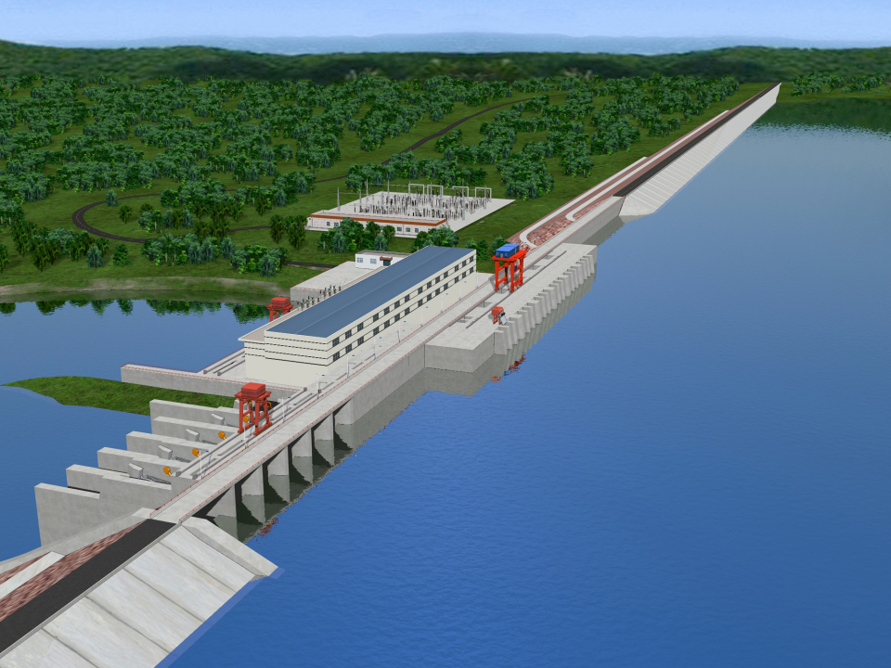
Brief of Bedden HPP
Catchment area 450,000km²
Annual mean runoff 33.36 billion m³
Installed capacity 780MW(6×130MW)

Slide 25
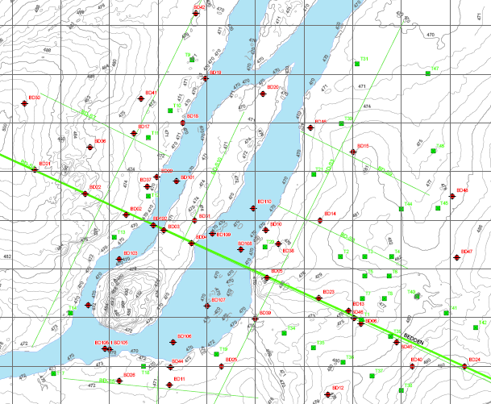
Bedden geotechnical drilling location

Slide 26
BEDDEN HPP ENVIRONMENTAL & SOCIAL IMPACTS:
Bedden Hydropower Project is well placed with respect to environmental and social implications during development and operation.
Very few people in 2010 live in the future reservoir area or downstream within the Project impact area; care will need to be taken with the development of the Jebel Bunggu quarry for concrete aggregates. The mitigation measures are discussed in Bedden ESIA report.
Benefits will accrue from the Project through the development of commercial fishing and sustained agriculture…...

Slide 27
Bedden HPP Project Cost and Economics:
The total cost for Bedden Hydroelectric Project has been estimated based on early 2010 prices at $1,452.22 million.
The Civil design and construction and electromechanical equipment design, manufacturing, delivery, installation and commissioning of 6 units are expected to be completed within 5 years. Energy will be available from the first unit at the end of Year 4 of the construction period.
The financial cash flow (Capex) would be:
259,229,122 USD for the first year;
254,223,838 USD for the second year;
290,443,955 UDD for the third year;
232,405,282 USD for the fourth year;
234,475,482 USD for the fifth year; and
181,442,094 USD for the sixth year.
The financing of the Project then was assumed to be Government debt through development loans from funding agencies.
The baseline financial analysis shows for a Project FIRR of 15% real,
the delivered cost of energy to the Juba East Substation is USD 0.12 per kWh.

Slide 28
Bedden HPP construction planning :
A 72-month implementation programme has been proposed for Bedden Dam project.
This comprises the following:
Review of Feasibility Study, Tender Documentation, Tendering - 12 months
Detail Civil design and construction, and Electromechanical equipment design, manufacturing, delivery, installation and commissioning - 60 months
The critical path is through the following sequence of works:
Detailed engineering;
Diversion coffer dams;
Overflow spillway;
Orifice spillway;
Powerhouse civil works; and
Electrical & mechanical equipment manufacturing, installation and commissioning.

Slide 29
JUBA REGIONAL GRID:
The development of Bedden would entails that the Juba Regional Grid has to be developed concurrently with the construction of Bedden Hydropower Dam.
The recommended configuration was that Bedden Power Station would directly be connected to the Juba East substation by a 220 kV double circuit transmission line.
While in the nearest future, Fula would be connected to Shukoli and then to Lakki Power Station switchyard by two 500 kV single circuits. Two 500 kV single circuit transmission lines from Lakki switchyard will carry the total load to a ‘Common Station’ located at Juba East in the outskirts of Juba.
It was envisaged that the excess power would be transmitted to Northern Sudan by a 500 kV HVDC double circuit line, for which the required DC terminal station would be nominally located adjacent to the Common Station.
The supply of power to JRG is from the Juba East substation. A double circuit 220 kV transmission line would connect Juba East to Juba West. The proposed Juba Barrage Project would also be connected to Juba West. Juba and Mongala would be supplied by 33 kV feeders from both Juba East and Juba West.
Juba West will supply Mundri load by one 220kV double circuit transmission line. The Mundri load was estimated as small but a double circuit line was justified since Mundri will be the future link for supply in the Rumbek - Wau direction and Meridi – Yambio direction.
A 110 kV double circuit transmission line would supply the loads at Yei substation. 33 kV feeders will supply the counties between Juba and Yei.
Juba East was proposed to supply Torit by a double circuit 110 kV double circuit line. If cement factories and lime kilns will be developed in Kapoeta, a 220 kV circuit line would be appropriate to connect Juba East to Torit and further to Kapoeta (subject to studies). 33 kV feeders would supply the counties between Juba and Nimule (with support from the appropriate power station auxiliary supplies) and Juba to Torit and beyond.
A 220 kV circuit line would connect Juba East to Bor town.
It was envisaged that some double circuit lines will be strung initially as single circuit lines.

Slide 30
Estimated Costs of BEJHP Stage1 Transmission Lines
Stage 1stage 1 circuits | Length (km) | Estimated cost (million USD)
Juba East-Juba West, 220 kV Transmission Line# | 10 | 2.64
Juba West-Mundri, 220 kV Transmission Line | 171 | 36.9
Juba West-Yei, 110 kV Transmission Line | 136 | 23.13
Juba East-Torit ,110 kV Transmission Line * | 122 | 20.75
Juba East-Bedden, 220 kV Transmission Line | 26 | 8.00
Stage 1 Total Transmission Lines Cost |  | 91.42

Slide 31
Estimated Costs of BEJHP Stage1 substations
Stage I substations | Estimated cost (million USD)
Juba East 220/110/33 kV | 40.08
Juba West 220/110/33 kV | 34.35
Mundri* 220/33 kV | 10.48
Yei* 110/33 kV | 5.81
Torit* 110/33 kV | 6.12
Bedden# 220 kV | 11.55
Stage 1 Total Substation Cost | 108.39
Total Cost of Full BEJHP Transmission System would be 432 million USD (Stage 1 and 2)

Slide 32
BENEFITS OF THE BAHR EL JEBEL HPP:
The benefits of the development of the hydropower potential on the Bahr el-Jebel and other tributaries are summarised below:
The development of each dam would contribute to national and State’s economic development and improved quality of life through provision of reliable power supply at the lowest possible cost;
Provision of an environmentally friendly energy source (reduced GHG emissions);
Regulate flows of the Bahr el-Jebel River and improve flood control in the area of Jonglei especially Bor town;
Promote development and reduce unemployment in the surrounding urban areas, either directly through implementation of the Project or the development of industries and business supported by the reliable power supply created by the Project, this in turn would promote peace as the youth would have jobs;
Access to energy is central to issues such as security, climate change, food security, strengthening the economy, improvement in education, improvement in health just to mention a few.
The development of the BEJHPP would incentivise digitization of South Sudan.
Promote particular industries that have been identified as potential beneficiaries of the reliable power supply created by the Project such as mining of the rich mineral resources in the surrounding areas and development of the fisheries industry, Kapoeta cement plant, paper industries, oil processing industries, steel industries…;
The development of the immediate reservoir area for recreational and tourism uses;
The rural electrification development would provide the local communities with access to the reliable power supply created by the Project; and
Recharge of underground water.

Slide 33
Industries that would benefit from hydropower
The development of the Bahr el Jebel Hydropower Projects could be a turning point for development of:
cement & lime factories in areas like Kapoeta,
glass factories;
paper factories,
oil processing factories,
mango juice canning factories,
steel factories,
Mongalla sugar factory,
fish canning factories,
gold refineries and other factories just to mention a few.

Slide 34
RECOMMENDATIONS:
Government should create an enabling environment for private sector investment in power generation within South Sudan; restructure SSEC and strengthen laws and regulations governing the electricity power sector.
It is recommended that the Bedden Hydropower Project be given the first priority to be executed by the government of South Sudan. we need to gain market confidence through prioritising projects with clear implementation timelines within politically stable environments to ensure project completion
The Bedden HPP should be prioritized in our national development plan if not already included. The medium and mini hydropower projects should be prioritized as well.
There should be a political will from the top leadership of the country to execute the project.
The populace should be mobilized and sensitized for such a big project.
The government should undertake measures to improve national security.
The government of South Sudan should commence negotiations to secure foreign investment from international financing institutions and funding agencies for the Bahr el Jebel HPP.
The Ministry of Electricity and Dams should create the Bedden Dam Project Implementation Unit (BDPIU) to oversee the implementation of the project.
In parallel to above, the government needs to solicit consulting firm(s) to update the 2010 studies and embank on detail studies for the interconnections.
The government needs to kick-start the process of seeking for no objections from her neighbours and the NBI countries for the execution of the Bedden HPP. This can be done through the presidency and the ministry of foreign affairs.
The government as an alternative could mobilize government funds (oil for Infrastructure through the budget process) and set aside 15-20% of the total cost; and to start lobbying & seeking for funding from financing institutions, seek Chinese government support in the form of public lending through the China Export-import Bank (China Exim Bank) and Arab funds. (AVOID THE DEBT TRAP)
The Arab states played a major role in funding for the Merowe Dam, Upper Atbara Dams Complex (Burdana and Settit Dams) and the heightening of the Roseires Dam in Sudan. Our government could as well lobby for financing from the Arab States. Other potential sources of funding could be from the AfDB; the BRICS bank…etc

Slide 35
Bedden Dams Project Implementation Unit (BDPIU)
The BDPIU should immediately commence to process with relevant authorities and actors for the following:
Secure access to land for the Dam, roads, township, temporary camps, temporary bridges and quarries;
Secure allocation of land for substations in Juba East and Juba West;
Secure exclusive allocation of Jebel Bungu for concrete aggregates;
Secure exclusive allocation of Khor Bejang & Kit for sand filter material;
Commence (with the demining authority) clearance of land mines around Jebel Bungu and the construction areas on west bank of Bedden Dam and townships
Kick-start enlightenment of the general public and the community about the project;
Coordination of community engagement arrangements;
Coordination of grievances management;
Coordinate and commence relocation of identified archaeological /burial sites (graves);
Coordinate with the state & community for accompanying development projects (roads, schools, dispensaries, drinking water, rural electrification.. etc) with the view of contributing to local territorial planning and development;
Coordinate household resettlement survey; and
Sensitize different sectors of government to plan to fully utilize this eminent cheap and clean energy.

Slide 36
End
GOD BLESS YOU
THANK YOU FOR LISTENING

