Slide 1
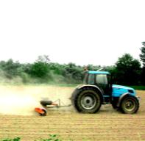
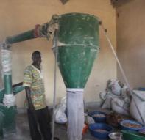
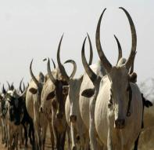
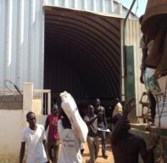
South Sudan’s National Effort for Agricultural Transformation (NEAT) and Strengthening Food Security
Dr. Betty A. Ogwaro
Juba, South Sudan
5th Sept, 2023

Slide 2
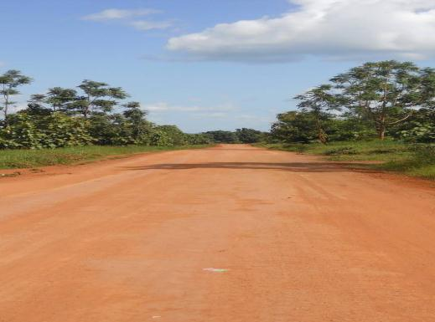
The National Effort for Agricultural Transformation (NEAT) will drive South Sudan towards its 2040 Agricultural Vision A vibrant, commercial and modern agricultural sector that sustainably supports South Sudan’s development in the context of devolution, short-term national aspirations for 100% food security, and longer-term global CAADP and the SDG especially 2 commitments which calls for ending hunger, achieve food security and improved nutrition and promote sustainable agriculture.
South Sudan has a vision for a transformed agricultural sector
The National Effort for Agricultural Transformation (NEAT) will achieve this vision
Improved production so the country is food secure and self-sufficient in the region
Improved health and nutrition across the country
Agriculture as an alternative economic engine complementing oil and gas
Increased incomes for >80% of the population
NEAT has two integrated components: the Zonal Effort for Agricultural Transformation (ZEAT) and the Comprehensive Agricultural Master Plan (CAMP)
ZEAT is a highly prioritized zonal approach ready for rapid implementation by the rainy seasons of 2024 and 2025
CAMP is a complete strategy covering agriculture and related sectors for all states and communities, to guide the country to full national and household food security; implementation should begin by 2025

Slide 3
Achieving this vision requires a comprehensive and coordinated response from all stakeholders
NEAT is an RSS-led effort with clear roles for all stakeholders:
Fundamental Operating Principles:
MAF, State governments, Private sector entrepreneurs, donors, implementing partners, and farmers will follow Paris declaration principles:
1
Mobilize the private sector to unleash agriculture as the core
driver of future growth and stability
Ownership: Partner countries exercise effective leadership over development strategies and co-ordinate actions
Alignment: Donors’ base overall support on partner countries' national strategies, institutions and procedures
Harmonization: Donors' actions are more harmonized, transparent and collectively effective
Managing for Results: Managing resources and improving decision-making for results
Mutual Accountability: Donors and partners are accountable for development results
2
Employ market-based solutions to activate public and private
investments
3
Empower farmers and entrepreneurs to reach their full potential
4
Integrate interventions to achieve momentum and scale
5
Collaborate with diverse stakeholders to build on strengths and distribute risk

Slide 4
The National Effort for Agricultural Transformation
NEAT is an ambitious Government of South Sudan policy that articulates and shapes the agenda for investments in agricultural development in the country. The policy further provides a framework through which donors, the private sector and stakeholders can coordinate and work together to support agricultural transformation in South Sudan.
NEAT is a 25 years plan based on CAMP: Revised every 5 years.

Slide 5
The Agricultural Transformation will be achieved through two integrated components of NEAT
the Comprehensive Agricultural Master Plan (CAMP).
CAMP is a complete strategy covering agriculture and related sectors for all states and communities, to guide the country to full national and household food security.
and
the Zonal Effort for Agricultural Transformation (ZEAT)
ZEAT is a highly prioritized zonal approach ready for rapid implementation. It is managed through State effort for Agricultural transformation (SEAT) and Bahr-el Gazal effort for Agricultural Transformation (BEAT).

Slide 6
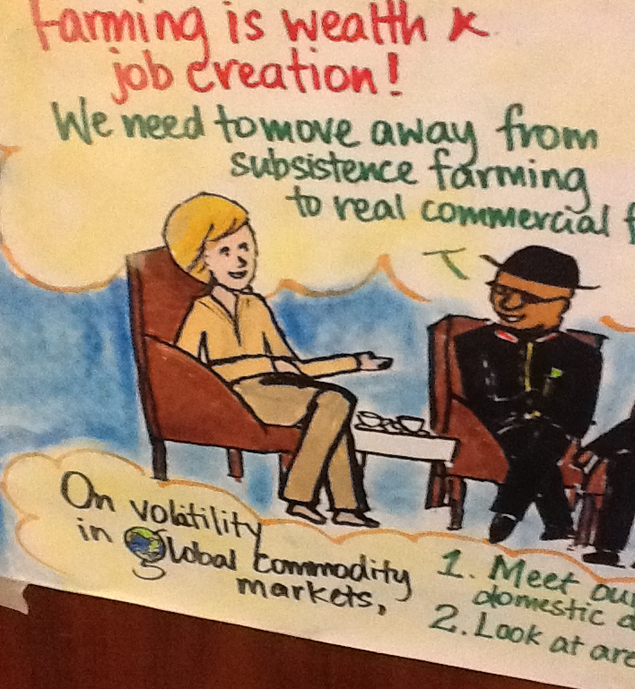
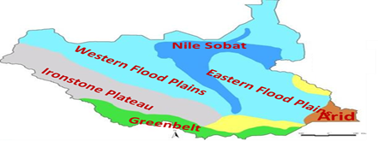
Agro-ecological zones
the Ironstone Plateau (lateritic soils).
The Central Hills, along the Nile to the north of the Green Belt.
The Green Belt.
The Imatong mountains along the Uganda border.
The Flood Plains including the Sudd a vast area of swamp.
The Nile–Sobat Corridor along the banks of the River Sobat which flows from Ethiopia and receives numerous tributaries before draining into the Nile.
A semi desert area in the extreme southeast.

Slide 7
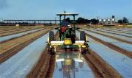
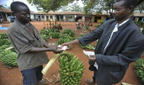
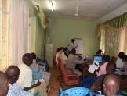
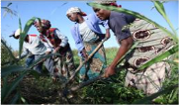
There are four types of agricultural programs that are part of this vision
Direct support to NEAT activities:
2. Programs supporting cross-cutting enabling activities
3. Support to NEAT implementation unit.
4. Additional agricultural programming

Slide 8
The transformation approach and Key areas for success
Increase small scale farmers’ productivity and value addition
ii. Secure Land Tenure
iii. Encourage Agriculture as a business
iv. Enhance the Irrigation Sector
v. Introduce mechanized farming (animal traction and tractors)
vi. Incorporate Rural Development Strategies
vii. Encourage Public-Private Partnership

Slide 9
Achieving this vision requires a comprehensive and coordinated response from all stakeholders
viii. A strong enabling environment via research, and policies.
ix. Enhance trade
x. Development of Rural Infrastructure
xi. Skills training programs for youth and women-led leaders, and extension agents
Manage shocks (climatic change (flood, drought), disease and pests and weeds control

Slide 10
Direct support to ZEAT activities cont…
Increase agricultural output and value addition
The programme will set-up 6 agro-processing hubs across South Sudan using a one-stop-shop rapid Public Private Partners for local and export markets.
Unlock 100 large-scale private farms (larger than 2,500 acres) and sustainable water supply for more than 300,000 acres of irrigation from existing infrastructure (Renk and other areas)

Slide 11
3. Programs supporting cross-cutting enabling activities
Investments that promote a strong enabling environment for agriculture via research, trade, land, and private sector development programs and policies.
1.m high-needs farming households and empower them to access a range of inputs from multiple providers, enabled by supporting years 1-2 preparation delivery system

Slide 12
4. Support to ZEAT implementation unit
Investments that promote the recruiting, staffing, training, and ongoing administrative needs of the NEAT implementation organization.
Skills training programs for NEAT leaders, youth and women-led leaders and extension agents
All four types of programs are essential for agricultural development
A shared vision for each type of program will help align all stakeholders

Slide 13
Documenting all Agricultural programs in South Sudan
This plan will serve as a framework to align all stakeholders around a common approach towards agricultural investments in South Sudan, including zonal transformations and coordinating investments
This framework allows stakeholders to share information about their ongoing programs and proposed new investments
An Excel file with detailed instructions will be distributed for all States, counties and Development Partners to easily list programs. Then the NEAT technical working team will compile all programs in this plan
The compiled program summary from these worksheets will be shared across all stakeholders to provide a common information base and allow the Ministry of Agriculture to balance resources against programs

Slide 14
Guiding principles to help complete investment matrices
PRINCIPLE
EXAMPLE
The Government, Donors/Development Partners should ideally commit to most of the activities for a geography to reduce handoffs
A single donor should support farmers in production and marketing rather than dividing and risking a failure to link
Donor/Development Partner commitments should be for multiple years to build local knowledge
Development Partner A funds the training of 30 entrepreneurs in year 1, and builds on successes to scale to 100 by year 3
Investment commitments should take advantage of the unique strengths of the implementer
Implementer A specializes in warehouse management, while Implementer B utilizes teams already on-the-ground in some counties
The Government through the National and State ministries must contribute resources to activities, not just depend on donor commitments
State Ministry of Agriculture with support from the Development partners trains high-performing extension agents and deploys them to priority counties

Slide 15
A Completed ZEAT Investment plan
1
There is a completed investment plan for the ZEAT in all the States in partnership with other line ministries and development partners.
Phase1:
Greenbelt
Hills and Mountains
Eastern Flood Plains - North
Phase 1: Farmers ready area. Relatively easy access to the market
2
2
3
Phase 2: High production area
Phase 2:
Western Flood Plains
Ironstone Plateau
Arid
1
Phase 3:
3
Phase 3:
Eastern Flood Plains - South
Nile Sobat

Slide 16
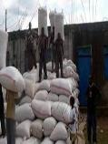
Prioritize supporting cooperative associations and commercial farmers to buy and sell at scale
The interventions will be:
Projected results and costs:
Support existing associations and develop new associations per state
Build on existing successes (e.g.,
Construct or rehabilitate warehouses and ensure proper fumigation
Link associations to large traders and develop processing opportunities
Provide quality extension and input subsidies
Support 15,000 farmers over 3 years with 40 B SSP of public funds and …….. B SSP of farmer/ association funding:
Average cultivated land from 2.5 to 3.5 feddans
Yield from 1 to 2 MT/feddan
Post-harvest loss reduces from 40% to 15%
Rehabilitate 1,260 km of road at SSP ………...............M cost
Engage 15,000 farmers over 3 years
Boost commercial farmers to expand land or develop out growers through loans and input subsidies
Rehabilitate trunk roads to Juba ad Wau and area feeder roads
Rehabilitate river transport Juba-Renk
Critical requirements for success:
Funding for roads mobilized quickly so increased production does not spoil
Farmer associations are sustainable and private-sector oriented—not dependent on relief
Agriculture cost: SSP 88 M
Infrastructure cost: SSP 600 B
Total cost: SSP 688 B

Slide 17
Key success factors for strong, independent associations
What will it take?
ü
Identify leaders of small farmer groups to form the foundation of each cooperative, through intensive recruitment and training
What will be created?
ü
Provide training to create a small, professional management group for each cooperative to represents the interests of its members
Co-operative associations that are profit-oriented businesses that independently organize and support farmers
ü
Facilitate access to finance for each association to ensure sustained success beyond government/development partner support
ü
Connect associations to institutional buyers and private traders to purchase harvest

Slide 18
Access a range of inputs from multiple providersInvestment Plan
3-year costs, SSP, ‘000
Public/Donor
Private/Farmer
Total
Component
Major activities (over 3 years)
Co-op organization
Organizers to form 4 new co-ops and strengthen 3existing co-ops
-
Input supply
Grants for 7 co-ops to purchase 10 kg seeds, 500 mL crop protection per feddan for 1 year
Land clearance
Grants for 7 co-ops to to expand land under cultivation by 5 feddans/farmer
-
Warehousing
500 MT warehouses for 4 new co-ops
Grants for equipment/fumigation for 7 co-ops for 1 year
Processing
2 MT/day maize mills for 7 co-ops
Grants for fuel/maintenance for 1 year
Marketing
Trucks for 3 existing co-ops
Grants for truck hire for 4 new co-ops
Radio advertising of produce for 7 co-ops
Training/
Extension
Extension agents for farmers in 20 focus payams
Market infor-mation system
Build market information team at the state level to track and communicate prices (3 analysts)
Infrastructure
Trunk and feeder roads connecting production area to the market
Total
SOURCE: Ministry of Agriculture, implementation partner, field interviews

Slide 19
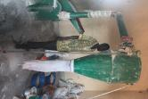
Prioritize supporting agro-entrepreneurs and farmer associations to provide smallholder value-chain services
The Ministry’s interventions are:
Spur 100 entrepreneurs to fill gaps in the value-chain for farmers and groups
Mechanization service (tractor and bulldozer) expands land clearance
Input dealers sell quality seeds and plant protection
Warehouses and processing improve market opportunities
RSS provides extension training and subsidies
The projected results and costs:
Support 12,000 farmers over 3 years with ….M SSP of public funds and ..M SSP of entrepreneur operating costs
Land cultivated increases from 2 to 5 feddans
Yield increases from 0.8 to 1.6 MT/feddan
Post-harvest loss reduces from 30% to 15%
Rehabilitate 545 kms of road at …M SSP
Engage 15,000 farmers over 3 years
Support 4 private associations with out-growers to through organizing, warehouse and transport support
Rehabilitate mmajor food security roads, and construct new feeder roads
Agriculture cost: SSP ………
Infrastructure cost: SSP ………
Total cost: SSP …………….
Critical requirements for success:
Solid talent-pool and financial resources to mobilize entrepreneurs
Quick improvement of roads connecting farmers and markets

Slide 20
Key success factors for private sector agro-entrepreneurs
What will it take?
ü
Establish clear expectations and contracts with entrepreneurs detailing support, performance targets, and consequences for management failure
What will be created?
ü
Provide ongoing training to each entrepreneur on business and technical management (e.g. accounting, marketing, warehouse cleaning)
Private sector entrepreneurs that are able to connect with smallholder farmers and FBOs and create sustainable linkages along the value chain
ü
Connect entrepreneurs with service support (e.g. mechanics for tractors & mills, warehouse suppliers)
ü
Connect entrepreneurs to smallholder farmer groups to help groups to grow and ensure businesses have a market for their services

Slide 21
Increase agricultural output and value addition
Public/Donor
Private/Farmer
Total
Component
Major activities (over 3 years)
Warehouse operator
Establish/train 35 warehouse operators to purchase locally
Construct 40 500MT warehouses and equipment
Start-up capital for seasonal offtake purchases
Tractor/Bulldozer hire
Animal traction
Establish/train 24 mechanization providers across the state
Purchase 20 75hp 4-wheel tractors and 4-bulldozers
Ongoing fuel and maintenance
Processors
Establish/train 20 processing operations focused on maize
Purchase 20 2MT/day maize mill
Construct 20 150MT stores near mills
Seed dealers
Establish/train 20 seed and input dealerships
Support 20 stores to start-up
Subsidize initial stock of improved seed
Private association
Organize/train 4 private associations to aggregate supply
Construct 4 1000MT warehouse
Purchase 4 20MT-capacity lorry
Extension
20 public extension agents reactivated to cover all payams
Agent salary
Motorcycle
Infra-structure
………. kilometers of trunk and feeder roads connected to the market
0
Total

Slide 22
Year 1:Boost household food resilience through Public/Donor investments
RSS commitments
Entre-preneur support
1 tractor
Operation training
2 tractors
Operation training
1 tractor
Operation training
2 tractors
Operation training
Mechaniz-ation hire
1 dealer
Seed training
Startup grant
2 dealers
Seed training
Startup grant
1 dealer
Seed training
Startup grant
2 dealers
Seed training
Startup grant
Seed dealer
1 mill
1 150MT store
Mill training
2 mills
2 150MT stores
Mill training
1 mill
1 150MT store
Mill training
2 mills
2 150MT stores
Mill training
Processor
Warehouse operator
2 500MT warehouses
Mgmt training
4 500MT warehouses
Mgmt training
2 500MT warehouses
Mgmt training
4 500MT warehouses
Mgmt training
Association with outgrowers
Organizing
Organizing 1 large coop
Infra-structure
1000MT store
Lorry
Extension service
Salary
4 extension agents (1 agent per county)
Agronomy training
Support
4 motorcycles and supplies

Slide 23
Prioritize establishing community block farms that clear new land and aggregate production
The interventions will be:
The projected results and costs:
Support 300 community block farms over a 3 year period
Each farm has 100 smallholders with 5 feddans/farmer
Subsidize land clearance
Provide intensive training through extension and subsidize seeds, crop protection and plowing
Construct warehouses to aggregate output on each farm
Support 30,000 farmers over 3 years with public funds and farmer/ association:
Cultivated land from 5 to 10 feddans (2 at home; 2 on block)
Yield from 0.4 to 1.2 MT/feddan
Post-harvest loss reduces from 30% to 15%
Participating farmers also improve home plot production
Farmers go to market with surplus
Rehabiliate 326 kms of road at ……….SSP
Engage 15,000 farmers over 3 years
Rehabilitate feeder roads the production areas
Critical requirements for success:
Funding and labor mobilized quickly to clear huge amounts of land (possible army or DDR program)
Market focused training and connection to output markets
Agriculture cost: SSP ……..
Infrastructure cost: SSP ……….
Total cost: SSP ……..

Slide 24
Key success factors for self-sustaining block farms
What will it take?
ü
Identify and develop capable farm managers for block farm operations—ensuring managers are incentivized based on farm success
What will be created?
ü
Self-sustaining block farms that are business-minded and do not need ongoing subsidies or support
Facilitate access to finance and training for each block farm to ensure success after development partners leave
ü
Connect block farms to institutional buyers and private traders to purchase harvest

Slide 25
Summary: Block Farming Investment Plan
PRELIMINARY
3-year costs, SSP, ‘000
Public/Donor
Private/Farmer
Total
Major activities (over 3 years)
Component
Identify 90 farm groups interested in block farming
Develop and agree by-laws
Build capacity for group to work as an institution
Select and hire farm managers
…
Group formation
Land clearance
Secure 90 separate 200-feddan tracts of land
Clear land while reserving necessary trees
Hire surveyor to demarcate farm into 2 feddan plots
…
Farming
Conduct on-farm agronomic training course (extension)
Seed purchase (25% subsidy each year)
Plowing and harrowing (100% subsidized in the first year)
Crop protection (50% subsidy each year)
Aggrega-tion
Construct 100 MT warehouses
Train co-op manager on systems and fumigation
Annual fumigation costs (100% subsidy in first year)
Marketing
Build market information team at the state level to track and communicate prices (3 analysts)
Market-oriented training on how to link to buyers
Radio advertisements of output
Infra-structure
5 priority feeder roads to connect output and markets within the state
…
Total
SOURCE: Ministry of Agriculture, implementation partner, field interviews,

Slide 26
Years 1-3 Road Investments
Identified Agricultural Roads
70 kilometers - ……. . SSP

Slide 27
Documenting financial institution contributions to ZEAT strategy
Financial offering
Geographic focus (States)
No. loans extended
Average loan size
Total ag. lending outstanding
Institution
Cooperative lending
Lender A
……………
……………
200
SSP 000,000
SSP 0,000,000
Loans to registered coops/ FBOs
Loan guarantees
Sharing risk with lenders
Asset-backed lending
Allowing farmers to use farming assets as collateral
Commercial farm lending
Agriculture-focused commercial loan products

Slide 28
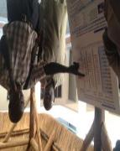
Documenting other cross-cutting enablers for ZEAT strategy
Institution
Enabling environment programs
Support-
ing strong
local
research
AGRA
(add actor here)
Established seed research centers for breeding and testing varieties (e.g. Palotaka)
(+ contributing activities)
Establish-
Ing land
security
USAID
………
Surveying and titling farmer landholdings in 2 counties
(+ contributing activities)
Creating
growth-
friendly
trade
policy
Ministry of Commerce
…….
Duty-free agricultural inputs, Customs policy (e.g. border clearance)
(+ contributing activities)

Slide 29
Documenting private sector investment in ZEAT strategy
Geographic focus for investment
Investor
Value chain focus
Nature of investment
Tractor dealer A
All areas
Production (mechanization)
Discounted leasing of tractors/bulldozers to 5 private associations
Animal traction dealer A
SOURCE: Source

Slide 30
The success of the transformation will depend on a creating a dedicated implementation unit
National transformations are deeply complex …
… Implementation units help overcome many of these challenges
Size and complexity of the challenge: NEAT encompasses 7 different zonal strategies across 10 states
✓
Follow a single, coordinated action and investment plan
Speed required: RSS has established a very near-term food self-sufficiency goal
✓
Minimize bureaucracy with a fast-acting unit
✓
Number of stakeholders: Transforming agriculture requires multi-sector cooperation as well as support from many development partners and the private sector
Bring together a team of high performing leadership
✓
Large financial commitments: Public sector and donor funding requirements are large and interdependent
Develop joint donor/ government monitoring to track progress

Slide 31
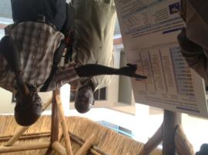
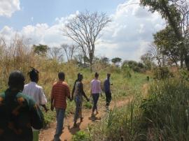
The unit will be responsible for the execution and management of the ZEAT agenda in each zone
The implementation unit will drive three consecutive processes :
Strategic design
Implementation planning
Delivery coordination
Design the quick-win strategic opportunity for each zone (focus on incomplete zones)
Translate strategic plans into clear, detailed action and investment plans for implementation
Coordinate implementation in priority zones—including regular progress reviews to course-correct

Slide 32
In Year 1, the Implementation Unit would support the first 3 zones with ~30 field staff--mostly seconded from existing Ministry employees
First phase implementation:
Eastern Flood Plains – North (Renk)
1 Zonal Director
2 Data/M&E Collection Agents
1 County Implementation leader
A State Effort for Agricultural Transformation (SEAT) team will provide policy and implementation guidance in each state
Renk
Ezo
Ibba
Mundri West
Mundri East
Nzara
Yambio
Maridi
Yei
Lainya
Kajo- Keji
Torit
Ikotos
Magwi
Morobo
Greenbelt Zone
1 Zonal Director
6 Data/M&E Collection Agents
12 County Implementation Leaders
Hills and Mountains
1 Zonal Director
5 County Implementation Leaders
Data collection shared with Greenbelt
1 Only includes new costs (i.e. salaries for staff who are already in the ministry are not counted)

Slide 33
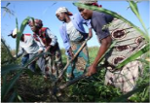
Successful programs outside the ZEAT should continue to receive support to promote household self-sufficiency
MAF promotes food security through two complementary and necessary approaches
National food security
Eliminate the country’s food deficit by aggregating and marketing smallholder production and supporting commercial farming
Immediate goal of the ZEAT
Take advantage of zones with a high number of market-ready farmers to quickly achieve increased production
Household self-sufficiency
Support households to grow enough food to meet basic needs and ultimately see farming as a business
Ongoing support for successful programs
Coordinate support from government and development partners to provide basic training and inputs to households and farmer groups
MAF should catalog all ongoing government and development partner agriculture programs to balance resources against them

Slide 34
Documenting additional agricultural programs outside direct ZEAT strategy Name of donor/development partner:
Government and development partners should describe programs outside of ZEAT on the worksheet below
Target population (Market-driven or household food security)
Target zone and specific state(s) (e.g., W. Flood Plains / NBEGS)
Commodity focus (e.g., maize, livestock)
Total increased production (MT)
Value-chain focus (e.g., inputs, post-harvest, marketing)
# small-holders reached
Program
Example:
On-Farm Demonstration Trials
Both market-driven and household food security
Greenbelt / WES, CES, EES
Maize
Production (improved inputs and agronomic techniques)
300 households
660 MT (Yield from 800-3000 kg/ HH )
1)
2)
3)
4)

Slide 35
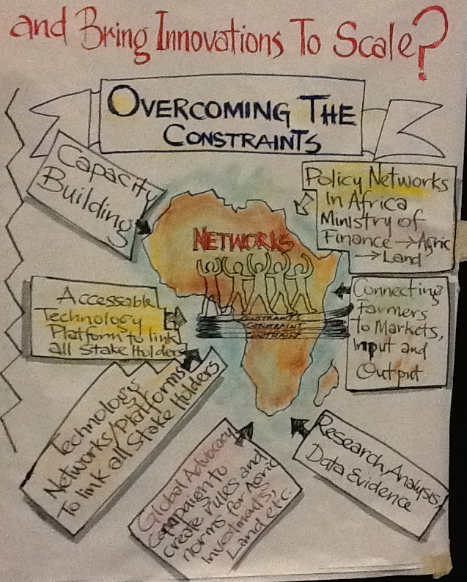
Overcoming the constraints

Slide 36
DELIVERING THE STRATEGY REQUIRES:
TRANSFORMATION ROADMAP
MONITORING AND EVALUATION
PEACE AND SECURITY
POLITICAL WILL & COMMITMENT
FINANCING AGRICULTURE BY 10% OF THE ANNUAL BUDGET
Further ZEAT details available upon request

Slide 37
THANK YOU FOR LISTENING

